Slide 1
The Federal Home Loan Bank System…
…and its Role in Preparing the Banking Sector for Rising Rates
December 2015

Slide 2
Today’s Topic “Bank”
Federal Home Loan Bank (FHLBank) System
Debt Issuance Program
Member Balance Sheet Trends
Member Borrowing Trends
Cautions & Considerations

Slide 3
Federal Home Loan Bank System

Slide 4
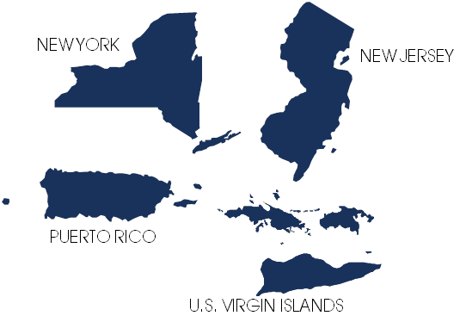

The Federal Home Loan Bank System
BEFORE MAY 31, 2015
AFTER MAY 31, 2015
FHLBNY SECOND DISTRICT
Government Sponsored Enterprise (GSE) created by Congress in 1932 as a result of the Great Depression and its effects on the housing market
Primary business is extending credit to banks, thrifts, credit unions and insurance companies
11 Federal Home Loan Banks across the United States all registered with the SEC and regulated by the Federal Housing Finance Agency (FHFA)
Each Federal Home Loan Bank is an independent cooperative, owned by its members, who purchase stock in the Federal Home Loan Bank
The total membership as September 30, 2015 was 7,255 institutions
The total Advances to members systemwide as of September 30, 2015 was $591 billion

Slide 5
FHLBanks Number of Members
The number of Members in the System accelerated post FIRREA, plateaued and has begun to decline.
FHLBank System Membership
1997
3Q2015

Slide 6
FHLBanks: Membership Changes
Net Membership Changes by District
from 4Q2008 to 3Q2015

Slide 7
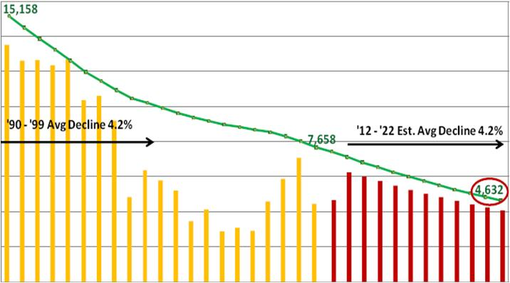
Consolidation in the Banking Industry
Number of Institutions Selling History
by FHLBank Territory (2009-2014)
800
16,000
Change
Est. Change
X
Total #Institutions
700
14,000
INDIANAPOLIS
BOSTON
SEATTLE
DES MOINES
48
77
78
NEW YORK
180
CHICAGO
63
600
12,000
152
PITTSBURGH
55
SAN FRANCISCO
TOPEKA
500
10,000
141
170
CINCINNATI
79
ATLANTA
NET CHANGE IN NUMBER OF BANKS 1990-2022
8,000
DALLAS
349
400
181
6,348
300
6,000
LOW # of Transactions
HIGH # of Transactions
Drivers for financial institutions to sell
200
4,000
Increased regulatory pressure
Rising operating expenses (technology, regulatory, human resources, etc) and shrinking net interest margins
Limited access to capital
Lack of growth opportunities due to intense competition
Lack of diversified income streams
Strategic Alliances: expansion into new businesses & new markets
Favorable trading multiples
Heavy insider ownership and private equity interest
Fear of accounting change
Board dynamics (fatigue, liability, retiring CEO)
100
2,000
0
0
1990
1991
1992
1993
1994
1995
1996
1997
1998
1999
2000
2001
2002
2003
2004
2005
2006
2007
2008
2009
2010
2011
2012
2013
2014
2015
2016
2017
2018
2019
2020
2021
2022
Source: FDIC - updated on Q2’15

Slide 8
Startup Banks Have Been Non-Existent
1992 – YTD 2015
Nationwide a De novo charter was granted in November 2013.
This marks the first De novo charter granted since 2010.
Start Community Bank (CT)
Bank of Bird-in-Hand (PA)
Regulators appear reluctant to approve new charters
Raising capital is challenging with expected returns shrinking
Recovery in the economy has not created demand for new banks
Regulators appear to want investors to infuse capital into existing banks versus De novos

Slide 9
FHLBank System Comparison
Composition by Members
# OF MEMBERS
Advances Outstanding by Institution Type
$ MILLIONS
* Please note that effective May 31, 2015, FHLB Seattle merged with FHLB Des Moines. Prior to that there were 12 FHLB districts.
Notes:
\\Nts-filesp1\Groups\Marketing and Sales\Marketing\2 Market Research\2 Market Research\Special Projects\HLB System charts\Presentations charts

Slide 10
Federal Home Loan Bank Advances
FHLBanks Advances (1988–3Q2015)
Federal Home Loan Bank of New York (FHLBNY) Advances (1995–3Q2015)
Notes:
There is no doubt that the tremendous amount of liquidity from HLB during the crisis was no sustainable. Hot money if you will, which many of our members have experienced and still do, was bound to retreat to members once the worst of the crisis was behind us.
2012 marked the first year that advances, on a system-wide level reverted from their historic lows.
While excess liquidity was the thematic reason for the decline, some HLB’s took it on the chin as:
A result of failures – (07-YTD12)
Atlanta – ~162
SanFran - ~58
Chicago - ~49
and the very important product composition which I will demonstrate is a crucial determinate of the declines.
Our HLB is clearly one of two banks that are above pre-crisis levels and number one in terms of growth since the crisis….those reasons will be highlighted.

Slide 11
Core Mission Assets Continues to
Be a Focal Point With the FHFA
Balance Sheet by Type of Assets

Slide 12
Debt issuance program

Slide 13
U.S. Based “AAA” Rated Institutions
 | S&P |  | Moody's |  | Fitch
Financials Institutions - Insurance | Fin. Strength Rating | Outlook | Fin. Strength Rating | Outlook | Fin. Strength Rating | Outlook
Northwestern Mutual Life Insurance Co | AA+ | Stable | Aaa | Stable | AAA | Stable
New York Life Insurance Co | AA+ | Stable | Aaa | Stable | AAA | Stable
Teachers Ins. and Annuity Assoc. of America | AA+ | Stable | Aa1 | Stable | AAA | Stable
TIAA-CREF Life Insurance Co. | AA+ | Stable | Aa1 | Stable | AAA | Stable
United Services Automobile Association | AA+ | Stable | Aaa | Stable | AAA | Stable
Financial Institutions - Banks | Long-Term Rating | Outlook | Long-Term Rating | Outlook | Long-Term Rating | Outlook
Depository Trust Company (The) | AA+ | Stable | Aaa | Stable | - | -
Federal National Mortgage Association | AA+ | Stable | Aaa | Stable | AAA | Stable
Federal Home Loan Mortgage Corp | AA+ | Stable | Aaa | Stable | AAA | Stable
Federal Farm Credit Banks | AA+ | Stable | Aaa | Stable | AAA | Stable
Federal Home Loan Banks | AA+ | Stable | Aaa | Stable | - | -
Federal Home Loan Bank of Cincinnati | AA+ | Stable | Aaa | Stable | - | -
Federal Home Loan Bank of Dallas | AA+ | Stable | Aaa | Stable | - | -
Federal Home Loan Bank of Des Moines | AA+ | Stable | Aaa | Stable | - | -
Federal Home Loan Bank of Pittsburgh | AA+ | Stable | Aaa | Stable | - | -
Federal Home Loan Bank of Atlanta | AA+ | Stable | Aaa | Stable | AAA | Stable
Federal Home Loan Bank of Boston | AA+ | Stable | Aaa | Stable | - | -
Federal Home Loan Bank of Indianapolis | AA+ | Stable | Aaa | Stable | - | -
Federal Home Loan Bank of New York | AA+ | Stable | Aaa | Stable | - | -
Federal Home Loan Bank of San Francisco | AA+ | Stable | Aaa | Stable | - | -
Federal Home Loan Bank of Topeka | AA+ | Stable | Aaa | Stable | - | -
Federal Home Loan Bank of Chicago | AA+ | Stable | Aaa | Stable | - | -
Financing Corporation | - | - | Aaa | Stable | - | -
Private Export Funding Corporation | A+ | Negative | Aaa | Negative | AAA | Stable
Resolution Funding Corporation | - | - | Aaa | Stable | - | -
Student Loan Marketing Association | - | - | Aaa | Stable | - | -
Tennessee Valley Authority | AA+ | Stable | Aaa | Stable | - | -
Industrial Institutions | Long-Term Rating | Outlook | Long-Term Rating | Outlook | Long-Term Rating | Outlook
Exxon Mobil Corp. | AAA | Stable | Aaa | Stable | AA+ | Stable
Johnson & Johnson | AAA | Stable | Aaa | Stable | AAA | Stable
Microsoft Corp. | AAA | Stable | Aaa | Stable | AA+ | Stable
13
Data as of 11/30/15
Please note that S&P affirmed their ratings in April 2011 but Moody’s and Fitch have not done so this year. This query was updated on April 26, 2011

Slide 14
Strong Presence in Capital Markets
GSE Debt Outstanding
Treasury Debt

Slide 15
Total Debt Outstanding
Total debt outstanding reflects advance demand from Members.
YTD Net Change:
($ in billions)
Debt Outstanding
---------------------------
Advances Outstanding
-135
------------
-152
-105
------------
-61
-4
------------ 8
79
------------ 73
80
------------ 72
8
------------
21

Slide 16
FHLBank Bond Issuance
Investor appetite for FHLBank Bonds remain strong both domestically and abroad.
Global Bond Investor Distribution
By Geographic Region
By Investor Type

Slide 17
FHLBank Bond Issuance
FHLBank Debt spreads to LIBOR continue to improve and spreads to treasury are historically tight.
History of Consolidated Obligations against LIBOR
5Y FHLB Cost of Debt vs. 5Y Treasury

Slide 18
Advance Rates
Advance rates are at historic lows and the shape of the Advance Curve is surfacing opportunities.
FHLBNY Advance Curve
Fixed-Rate Advances are at Historic Lows
New YTD Lows
1Y Adv: | 0.58 | On 1/14/2015
3Y Adv: | 1.19 | On 10/21/2015
5Y Adv: | 1.69 | On 1/14/2015
The Cost to Extend has Decreased

Slide 19
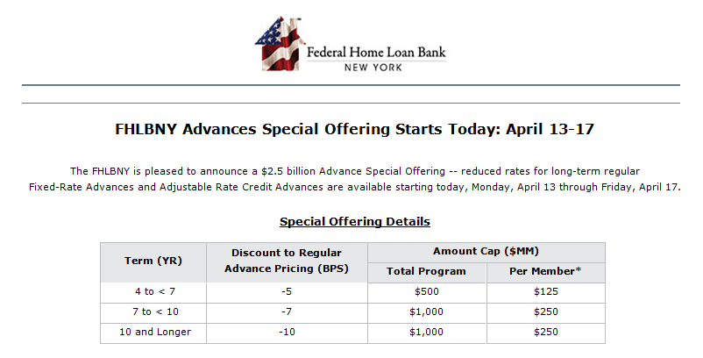
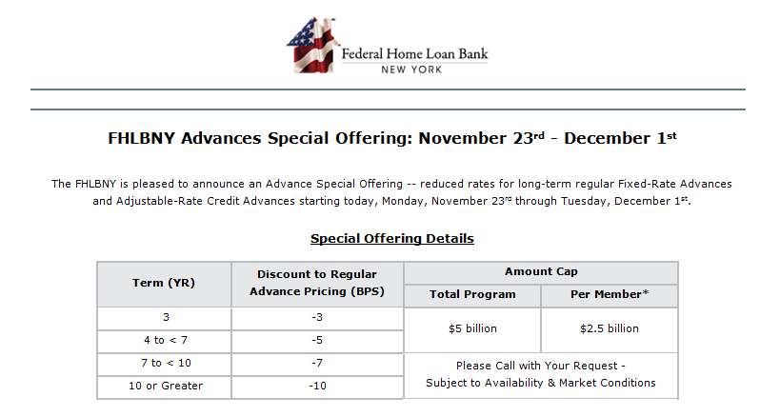
FHLBNY Advances Special Offering
The FHLBNY is dedicated to meeting the needs of our region’s local lenders. In 2015 the FHLBNY has provided members the opportunity to take advantage of reduced rates for long-term advances with our Advance Special Offerings.
April 2015 Special Offering
TERM (YR) | DISCOUNT TO REGULAR ADVANCE PRICING (BPS)
4 to < 7 | -5
7 to < 10 | -7
10 and Longer | -10
November 2015 Special Offering
TERM (YR) | DISCOUNT TO REGULAR ADVANCE PRICING (BPS)
3 | -3
4 to < 7 | -5
7 to < 10 | -7
10 or Greater | -10

Slide 20
Member balance sheet trends

Slide 21
Funding Gap Analysis: 2001- 3Q2015
Top 35 Borrowers & All Other Borrowers
Funding Gap: All Members
Notes:
from the HLB for the same term at the same price (assuming you have sufficient collateral at the HLB).
Day-to-Day Biz – Primary Liquidity
Generally short-term funding used for:
Retail deposits fluctuations - seasonal demand – geographic trends
Options on investments, mortgages, big CD’s and advances
Covering payment obligations (cash flow maturities) such as cash, P&I, security sales
Decline of market value in unencumbered assets
Loan commitments- general asset growth
Obtain Liquidity Through:
Usage of readily available assets that are easy to control and can be converted into cash quickly:
Retail Deposits
FF sold
Repo lent
investment securities P&I and monthly maturities
50% of average banks collateral is unpledged and most still carry a 5% of their assets in FF sold.
Average pledged securities is 50% in 06 versus 44% in 01Investment portfolio
investment securities and monthly maturities - P&I…and of course retail deposits via branch networks: stable, generally less rate sensitive, build franchise value, leads to opportunities to develop relationships and cross sell opportunities
Strategic Liquidity Planning – Contingent Liquidity
Generally long-term funding used for:
Origination inflows
Unexpected competitive deposit outflows
Countrywide / WAMU / Indymac CD levels during Subprime crisis
Emergency Funding - Y2K
JIT - HLB longer-term funding, reserves – brokered CDs, severe – FRB
Obtain Liquidity Through:
Sale or securitization of loans or other assets
Borrowings – HLB, FF purchased, brokered CDs, Repo and Fed Reserve
"Past" represents funding as it was in a "normal" environment, whether we will ever return to normal is open to discussion.
In "present", repo agreements were dropped down the list because many traditional repo counterparties are now gone (Lehman, Bear Stearns) and the ones remaining are 1) being more judicious about the extension of credit to the banking market, and 2) keeping it simple (bullet repo) and not getting too crazy with structured product. This could be a combination of the optics of dealing with structured product, and the fact that the yield curve shape and vol activity means that banks are not currently being rewarded for selling options embeded in a structured repo.
The Federal Reserve was moved up three notches due to the significant activity of the discount window, which moved up from its status of the "lender of last resort" to become a consistent source of short term funding, and the TAF program. In the "future" I am dropping the Fed back down because it's my perception that their government-backed mandate to provide massive liquidity will trail off in a more normalized enviroment, however I'm not dropping it all the way back down because I think there will be some core amount of borrowings remaining.
Fed funds lines, which are largely unsecured, were dropped down in the "present" environment for much the same reason as repos, i.e. that creditors are reticent to grant credit, especially unsecured, to other financial institutions in the present environment.
PR Institutions Expect Brokered CDs Balances to Decline As a Result of:
Deleveraging Balance Sheet to Maintain Above Well Capitalized Ratios
Lower Loan Demand
Borrowing from the Fed at Lower Rates
Concentrating on Raising Core Deposits
Does Not Add Franchise Value
Slight Pressure From Regulators

Slide 22
Industry-Wide, C&I, CRE, and Multifamily
Represent a Larger Share of Assets Versus Ten Years Ago
Balance Sheet Composition of All FDIC Institutions

Slide 23
Federal Agencies/GSEs Have Played an Increasingly Significantly Role in the Residential Mortgage Market (61% of $9.9TR as of Q22015)

Slide 24
Members’ Loan Growth
Year-Over-Year Growth In Members’ Total Loans & Leases
Multi-family Loans Is The Fastest Growing Category Of Members’ Loan Portfolio

Slide 25
Bank Lending Teams
SUMMARY
Bank lending teams are experienced teams of bankers that service commercial small to mid-market clients, often in metropolitan areas, as part of an ongoing effort to invest in high-growth areas and deliver a broad range of financial products and services to their clients. These teams reach out directly to their clients and have a certain amount of autonomy and independence to make decisions in the field quickly without being mired in bureaucracy. Most teams have expertise in small business lending including multifamily and commercial real estate. Recently, expertise has expanded into structure finance and asset lending. The size of teams can vary greatly from just a few individuals to 15 or 20. The average team consists of 6 to 10 members.
PURPOSE
Provide clients with creative structures and highly personalized service
Bring business to the clients: moving away from connotations of order tracking when business comes to the bank
Increase sales
Break the hierarchical mold and close loans as fast as possible
Operate on service, not price: These teams do not offer the best rates, but are growing tremendously because small firms want things to get done as soon as possible with the fewest amount of hassles
POSITIVES
Business gets done fast (i.e. can close a loan in 30-60 days) Teams have large amounts of autonomy and independence Most decision making can be done in the field and at a local sales office Lending teams report directly to senior management Convenient for the client (i.e. single point of contact) Teams have experience, depth, breadth of knowledge, and brings their relationships with them to their new bank
NEGATIVES
Poaching: Banks are poaching lending teams of other banks. This could cause the biggest institution to win out the business This model requires a high concentration of small to mid-sized businesses This model may reach a saturation point Local and political atmosphere can impact growth of small to mid-sized urban businesses depending on rules, taxes, and regulations imposed. This could cap the amount of lending teams needed Lending teams may have little or any loyalty to their employers

Slide 26
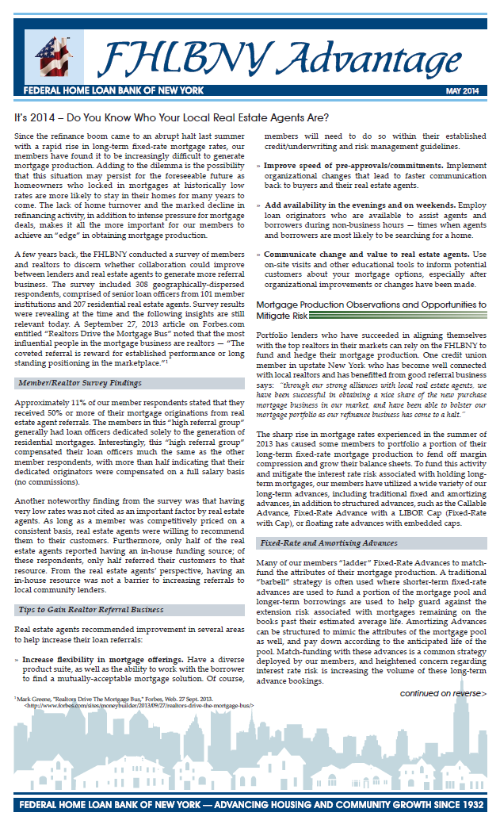
Consider Partnering
With Your Local Real Estate Agents
The FHLBNY conducted a survey of members and realtors to discern whether collaboration could improve between lenders and real estate agents to generate more referral business.
Tips to Gain Realtor Referral Business
Real estate agents recommended improvement in several areas to help increase their loan referrals:
Increase flexibility in mortgage offerings. Have a diverse product suite, as well as the ability to work with the borrower to find a mutually-acceptable mortgage solution. Of course, members will need to do so within their established credit/underwriting and risk management guidelines.
Improve speed of pre-approvals/commitments. Implement organizational changes that lead to faster communication back to buyers and their real estate agents.
Add availability in the evenings and on weekends. Employ loan originators who are available to assist agents and borrowers during non-business hours — times when agents and borrowers are most likely to be searching for a home.
Communicate change and value to real estate agents. Use on-site visits and other educational tools to inform potential customers about your mortgage options, especially after organizational improvements or changes have been made.

Slide 27

Crowdfunding
Crowdfunding is the practice of funding a project or venture by raising small amounts of money from a large number of people, typically using an internet portal.
Ideas
Investment Crowdfunding
$
Feedback
Crowdsourcing
$
Advice
$
Information
Problem
Solved
Idea
Funded
$
Online Crowdfunding platforms are positioned at the intersection to ensure investors and entrepreneurs collaborate
as well as invest

Slide 28
Crowdfunding Has Exploded!
In 2010
By 2012
In 2015
There were an
estimated
There were an
estimated
There are an
estimated
283
536
2933
Different Crowdfunding
Platforms
Different Crowdfunding
Platforms
Different Crowdfunding
Platforms
118
General Crowdfunding and Real-Estate Crowdfunding platforms are launching at a rapid pace.
Experts agree, Crowdfunding is destined to accelerate, with at least 15 additional Real-Estate platforms in pre-launch and many more likely planned.
New platforms are emerging quickly, particularly sites serving niche markets.
Are Real-Estate
Crowdfunding Sites
85
Are in the US

Slide 29
Member Borrowing trends

Slide 30
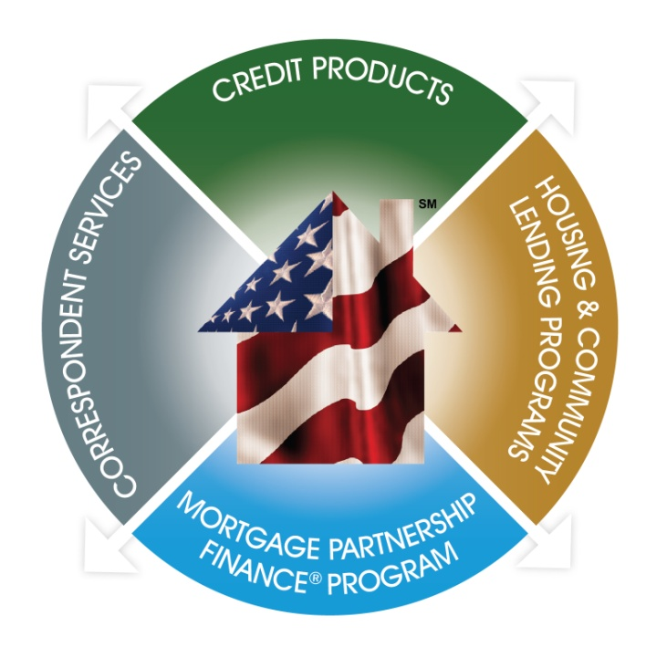
FHLBNY’s Mission
To advance housing opportunity and local community development by
maximizing the capacity of community-based member-lenders to serve their markets.
FHLBNY Lines of Business
The four business lines help meet Members’ needs & achieve the FHLBNY Mission.
Advance Characteristics:
TENOR:
Overnight to 30 years
TERM:
Fixed-Rate, Floating Rate, Callable, Putable, Forward Starting, or Amortizing
PURPOSE:
Liquidity management
Asset/liability management
  Transactional micro hedges
  Balance sheet macro hedges
Minimizing liability costs
Wholesale leveraging
Funding retail loan growth
Prefunding branches

Slide 31
Advance Trends
The growth in member balance sheets and the increased focus on interest rate risk
are the main drivers behind member funding preferences.
Member Advances Outstanding
Fhlbny Advances Issued & Still Outstanding
ALL MEMBERS:
Thrifts
32%,68
Commercial Banks
46%, 99
Insurance Company 19%, 6
102Bs 0.01%,
Credit Unions
3%, 29

Slide 32
Advances Outstanding by Type:
Our Advance Book is Becoming More Diverse
Year-end 2004 through Year-to-date 2015

Slide 33
What is Driving Members’ Need to Borrow?
Segmenting our markets to better understand our members’ needs is essential to designing effective products and strategies
Uses of FHLBNY Advances
FHLBNY Member Segmentation
Liquidity management
Asset/liability management
  Transactional micro hedges
  Balance sheet macro hedges
Wholesale leveraging
Funding retail loan growth
Prefunding branches
Types of FHLBNY Advances
Overnight to 30 years
Fixed or floating rate
Amortizing or bullet structure
Forward starting
Notes:
Segmentation based on members’ business motivation for using the Bank
Systematic Interest Rate Risk Managers
Institutions who use advances to hedge risk in the balance sheet with the appropriate products
Daily Liquidity Users
Generally borrow overnight advance products to fund daily cash flow needs
Leveragers
Institutions with excess capital looking to grow the balance sheet through leverage strategies
Non-Users
Institutions that irregularly borrow advances
Opportunistic Funders
Institutions whose primary consideration in the use of advances is rate
==============================================
Use of FHLBNY Advances
Liquidity management
Asset/liability management
Transactional micro hedges
Balance sheet macro hedges
Minimizing liability costs
Wholesale leveraging
Funding retail loan growth
Pre-fund bank branches
========================
PR Member
Leverager:1
Doral
Opportunistic: 4
FirstBank
Santandar
Oriental
Western
Daily Liq: 3
Banco Pop
R-G
Euro
System: 1
BBVA

Slide 34
How Members Use Advances to Fund Their Balance Sheet
30 Year FRM Balances in Various Rate Environments
Match Funding |  | Pool Funding
Individual Loans vs. Individual Advances/Deposits |  | Group Loans vs. Group Advances/Deposits (loans typically has similar characteristics i.e. type, collateral & purpose)
Advantages | Disadvantages | Advantages | Disadvantages
Easy to understand Easy to track Prepayments | Cumbersome portfolio grows | Fund in bulk Less tracking required | Prepayment assumptions are not always correct
Predominantly used for Commercial Loans |  | Predominantly used for Residential Loans

Slide 35
Prefunding Branch Development
WHAT CAN BE DONE TO REDUCE BRANCHING COSTS?
Reduce Operating Construction and Operating Costs
  Many institutions are opening smaller branches in an
  effort to reduce construction and operating costs.
  “New-style” branches— offices that look like retail stores
  are becoming popular in certain markets.
Branch Pre-Funding
  An alternative strategy for institutions that are members of the FHLBNY is to use
  our low-cost advance programs to pre-fund new branches.
  Branch pre-funding allows members to obtain wholesale funding at
  desired deposit projections rather than waiting for the deposits to materialize.
  By borrowing from the FHLBNY you can immediately begin investing the
  money that you plan to acquire with your expected new branch deposits.

Slide 36
Credit Products
Enhance your strategic flexibility with an FHLBNY credit product
  Overnight Advance
  Fixed-Rate Advance
  Fixed-Rate Advance with a LIBOR Cap
  Amortizing Advance
  Callable Advance
  Principal-Deferred Advance (PDA)
  Repo Advance
  Putable Advance
  Putable Advance with Customized Strike
  Adjustable Rate Credit (Callable ARCs available as well)
  Letter of Credit (L/C)/Municipal Letter of Credit (MULOC)

Slide 37
Fixed-Rate Advance With a LIBOR Cap
FIXED-RATE ADVANCE
WITH A LIBOR CAP
Fixed-Rate Advance
LIBOR Cap
FHLBNY
Member
Institution
The Fixed-Rate with Cap combines a fixed-rate borrowing with an embedded interest-rate cap in which the rate remains fixed but may be reduced quarterly if 3-Month LIBOR rises above the pre-selected cap (with a floor of zero).
This product provides long-term funding where a member can extend liabilities, lock in spreads and preserve margins.
The feature of the embedded cap will provide additional protection against rising short-term interest rates by lowering an institution’s cost of funds as rates rise.
Notes:
The Fixed-Rate with Cap combines a fixed-rate borrowing with an embedded 3 Month LIBOR-indexed interest-rate cap. It can help you to lock in spreads and preserve margins while offering additional protection against rising short-term interest rates. As 3 Month LIBOR rises, the cost of funds on this advance can lower, offsetting potential rate increases you may experience with your deposit base or other funding categories.
This advance provides members with the benefits of an interest rate cap and may be accounted for without the issues associated with stand-alone derivatives. As always, please consult your accountant in order to confirm the appropriate accounting treatment.

Slide 38
Example: 5 Year Fixed-Rate With Cap 1x Multiplier
In this scenario, the 5-year Fixed-Rate with 1x Cap with a strike of 2.50% would have an initial rate of 1.96%, 17 bps higher than the regular 5-year bullet advance. This illustration demonstrates that this advance rate would decline in a rising rate environment – As indicated below, once 3-Month LIBOR rises and breaches the Cap strike of 2.50% in Q1 of year 4, the Fixed-Rate with Cap would reset on quarterly basis, downward a basis point for every basis point 3-Month LIBOR is above the cap (floored at zero percent). If 3-Month LIBOR sets below the cap strike, the advance would return to its initial rate of 1.96% on the quarterly reset date.
2.50%
1.96%
0.32%
Notes:
The rate for this advance will remain fixed and reset quarterly if 3 Month LIBOR rises above an agreed upon strike cap, with the rate adjusting downward at that point. The advance rate will adjust depending on how many basis points 3 Month Libor is above the cap, either on a one to one basis (1 times) or by a basis point for every two basis points the index is over the cap (0.5 times), with a “floor” of zero percent. As rates rise, assets extend and liabilities re-price, the rate on the Fixed Rate with Cap will decline, lowering your cost of funds. If 3 Month LIBOR falls back below the cap the advance will return to its original fixed rate.
Let’s take a look at example of a hypothetical 5 year Fixed Rate with Cap, with a cap of 1.75% and one times multiplier, with an initial rate of 1.39%. We incorporated a rising rate environment in this illustration where 3 Month LIBOR steadily rises and breaches the cap in the third quarter of year 3. The Fixed Rate with Cap would remain at 1.39% throughout the first 2 years of this scenario, beginning to re-price downward in the third quarter of year three as 3 Month LIBOR rises above the 1.75% cap. By the end of year five in this example, 3 Month LIBOR reaches 4.41% and the advance rate is floored at zero percent. If 3 Month LIBOR never breaks through the cap the advance rate would remain at 1.39%.

Slide 39
The Callable Advance
The Callable Advance is a Fixed-Rate Advance that gives members the option of calling (terminating) the advance on predetermined dates, prior to maturity, without incurring a prepayment fee.
Benefits |  | Product Features
Competitively priced |  | Minimum Advance Size: | $5 million
Fixed-Rate for the life of the advance |  | Maximum Advance Size: | $100 million
No prepayment fee when called on specified date |  | Initial Program Size: | $3 billion
 |  | Final Maturities Available: | 3, 5, 7, or 10 years
Better cash flow match for fixed-rate mortgages & commercial loans held in portfolio |  | Lockout Periods: | 1, 2, 3, or 5 years
 |  | Call Options: | Bermudan (quarterly) or European (one-time)
Take advantage of downward movements in interest rates & steep yield curves
 |  | Interest Payment: | Quarterly based on Actual/360 day count
Good hedging tool against mortgage prepayment risk
Whole loan and security collateral is acceptable
 |  | Required Option Notification: | 9 business days

Slide 40
Community Development Programs
The popularity of the CI program has been growing, particularly in the New Jersey region as of late,
as Members have placed an emphasis on investing in their communities.
TOTAL CI ADVANCES (DAILY AVERAGE)
COMMUNITY LENDING PROGRAMS
Project specific uses of CIP, UDA & RDA Funds
Commercial/Economic Development
Housing
  Equipment Purchase for Small Business Expansion
  Debt Refinancing for Small Businesses
  Debt Consolidation for Small Businesses
  Handicapped-Accessible Vans
  Fire Stations and Trucks
  Grocery Stores
  Retail Stores
  Educational Facilities
  Healthcare Facilities
  Office Buildings
  Daycare Centers
  Origination of single-family mortgages
  Refinancing of single-family mortgages
  Financing of housing projects:
    Property acquisition
    Construction
    Permanent financing
    Re-financing
    Renovation/Rehabilitation
    Home Improvement
11/8/12 – FHLBNY initiates Disaster Relief Funding program (DRF), designed for Members to assist in rebuilding communities affected by Superstorm Sandy. FHLBNY allocates $1B in low-cost funding. Program closed 12/31/13.

Slide 41
Eligible Uses of Community Lending Program Funds
Community Investment Program (CIP)
Housing for families/individuals with incomes at 115% or less of the area median income
Finance facilities that benefit low- and moderate-income households:
  Provide services or permanent jobs for households with incomes at 80% or less of the area median income
  Located in neighborhoods where at least 51% of the households have incomes at or below 80% of the area median
Rural Development
Advance (RDA)
Finance Economic Development projects that benefit individuals or families at or below 115% of the area median income
  Project being financed must reside in a location (unit of general local government) with a population less than 25,000
Urban Development
Advance (RDA)
Financing for Economic Development projects that benefit individuals or families at or below 100% of the area median income
  Project being financed must reside in a location (unit of general local government) with a population greater than 25,000

Slide 42
Our Dividends Have Been Reliable and
Exceeded Market Reference Rates
FHLBNY Dividend History
Notes:
That NI performance has translated into Returns to shareholders have been very strong
Bars =
Lines =
Very nice spread of div rates over the market reference rates for this period
In fact, for awhile members were telling us that their NY HLB stock was the highest earning asset on their balance sheet
And many members tell us they calculate a “net” borrowing cost on advances that factors in the dividend payment

Slide 43
FHLBNY Dividend Returns Have Also Consistently
Exceeded Those of Other FHLBanks

Slide 44
Cautions & considerations

Slide 45
In General, Members Prefer to Maintain
Higher Advance Capacity Levels

Slide 46
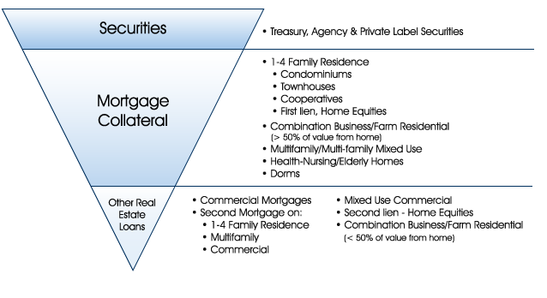
FHLBNY Eligible Collateral

Slide 47
Reduction in the Number of Members on the Watchlist Points to Improving Financial Health
MEMBERS’ FINANCIAL UPDATE
Earnings: Despite growing loan demand, margin pressure, persists negatively impacting earnings
Capital levels: remained strong for the majority of our members
Liquidity: On average, loans growing at a slightly faster pace than deposits, though members remain highly liquid
Asset quality: steady improvement across the board ; while credit costs remain elevated actual losses remain low,
Notes:
Advances/assets are PAR value, using end of quarter data
Citizens Bank
Bank of America
New Alliance
Salem Five
Washington Trust
Further Verification of Merged out and liquidated members needed!!!

Slide 48
FHLBNY Banks’ Credit Rating Trend (1Q2010 – 3Q2015)
LIQUIDITY - 10% Loans to Deposits Liquid Assets / Liabilities
ASSET QUALITY - 35% Charge Offs / Loans NPLs / Total Loans 30-89 PD / Total Loans
CAPITAL ADEQUACY - 35% Texas Ratio Leverage Ratio Tier 1 RBC Ratio Total RBC Ratio
Earnings - 20% NIM ROA ROE Efficiency
FHLBNY Credit Score Legend
1 - <2 | Excellent
2-3 | Very Good
4-5 | Average
6 | Special Mention
7-10 | Watchlist
Notes:
The Texas Ratio is generally defined as Nonperforming assets + 90 day past due loans/Tangible common equity + loan loss reserves
CREDIT RATING MODEL
Analyzes financial information of all members to monitor credit quality
Incorporates 13 ratios that focus on asset quality, capital levels, earnings and liquidity
Rating scale of 1 (excellent) to 10 (distressed
Rating of 7 or worse categorized as a “Watch list” member
Detailed quantitative and qualitative analysis prepared for all Watch list members to determine if a collateral category and/or haircut change are warranted

Slide 49
Lending Considerations
Borrowing potential (FHLBNY) credit limits
Borrowing limitations
Maximum overall exposure limit is 50% of member total assets
The ability to borrow non-repo advances above 30% of member assets will be subject to meeting certain eligibility criteria:
  Financial condition
  Sufficient eligible collateral discounted by market value adjustments (haircuts) and collateral maintenance levels
  Compliance with collateral reporting requirements
Members who fail to comply with reporting or documentation requirements
Members that exhaust their available eligible collateral
Members reaching credit policy model limits
Members that fall below adequately capitalized:
The Credit Policy & Review department will take action to limit the risk to the FHLBNY. Examples include limitations to:
  Restricted to Short Term Advances Only
  May be subjected to more stringent collateral requirements
  May be required to submit a capital plan
  May be required to receive approval of member’s primary regulator to continue accessing advances

Slide 50
Housing and Community Lending
Help turn home-ownership and community development dreams into reality
  Community Lending Programs
  Community Investment Program (CIP)
  Rural Development Advance (RDA)
  Urban Development Advance (UDA)
  Affordable Housing Program (AHP)
  First Home Club^{sm}

Slide 51

The Affordable Housing Program
A Strong Community Partner
10% of FHLBNY net income is earmarked for AHP projects
Provides subsidies to support the creation and preservation of housing for lower income families and individuals
Members apply in conjunction with community groups
Applications must support the purchase, construction,
or rehabilitation of owner-occupied or rental housing
Competitive program
Affordable Housing Program Activity in New Jersey
(since 1990)
Number of Grants Awarded: 456
Total Grant Dollars Awarded: $146,700,586
Total Units of Housing: 18,969
Total Estimated Development Capital: $2.93 billion
51

Slide 52



First Home Club^{sm} Overview
Provides down payment and closing cost assistance to first time homebuyers
First Home Club^{sm}
REQUIREMENTS:
Household income cannot exceed 80% of area median income
Member establishes dedicated deposit account and extends mortgage loan
Household must save for a minimum of 10 months
FHLBNY matches household savings 4:1 up to $7,500 per unit
Must participate in first-time homebuyer counseling (minimum of 6 hours)
Residential 1-4 family
BENEFITS:
Creates homeownership opportunities
Provides residential lending opportunities
Increases banking relationships
Enhances CRA credit
Creates partnerships with local
non-profit organizations
Enhances public relations and community position

Slide 53

Mortgage Partnership Finance® Program
Improve your competitive position with the
Mortgage Partnership Finance Program (MPF®)
Transfer interest-rate risk to FHLBNY
Maintain customer relationship
Retain or release servicing
Eliminate holding 30yr FRM in your own portfolio
Receive servicing & credit enhancement fees
The “MORTGAGE PARTNERSHIP FINANCE” logo and the “MPF” logo are trademarks of the Federal Home Loan Bank of Chicago
Notes:
Program rewards credit quality not volume

Slide 54
Continuous Educational Outreach Initiatives
We provide relevant education, emerging topics, and trends to our Members.
FHLBNY Resource Center — Created to Help You Maximize Your Membership
Gain access to educational information and various tools to help address your institution’s unique set of challenges, such as:
  Managing interest rate risk
  Increasing profitability
  Increasing Net Interest Margin
  Locking in spreads to preserve margins
Examples of the materials you can find:
  Strategy articles
  Presentations, Tutorials and Webinars
  Workshops and Tools
  Fact Sheets and Other Information
  Take advantage of this readily available center by visiting: www.fhlbny.com/members/resource-center
  Mitigating Net Interest Income at Risk and Economic Value of Equity at Risk
  Achieving asset/liability management goals without increasing the size of the balance sheet
Through the FHLBNY Resource Center you can also request a Member-Director Education Session
This program is specifically created for our Members’ Board of Directors and managers, and is customized to address their specific needs and concerns, as well as a wide range of issues commonly faced by
most community lenders.

Slide 55
“
As long as markets remain open, and a member has pledged sufficient qualifying collateral and is willing to purchase the requisite amount of capital stock, the FHLBNY will always continue to lend to our members to help you meet your community’s needs.
José R. González
President and CEO
”

Slide 56
Adam Goldstein
SVP, Head of Sales & Marketing
212-441-6703
goldstein@fhlbny.com

