Slide 2
Disaster Averted
Best Practices in Backup/Recovery and Disaster Recovery
Global DR Preparation Report Overview
Plan Development
Secondary Sites & Solutions
Questions

Slide 3
State of Global DR Preparation
Data Center Solutions
Annual Report
Disaster Recovery Preparedness Council
Annual Report analyzes and benchmarks trends from a mix of companies from across the globe.
Incudes recommendations for improving disaster recovery preparedness based on industry standard best practices:
• Environment Analysis
• Designing a DR Plan
• Testing to Validate Recovery
©2015 BY OXFORD NETWORKS

Slide 4
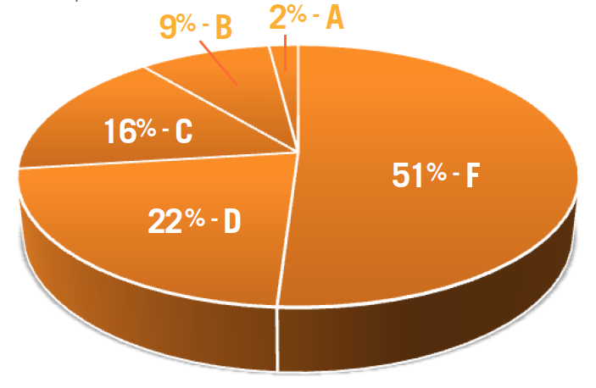
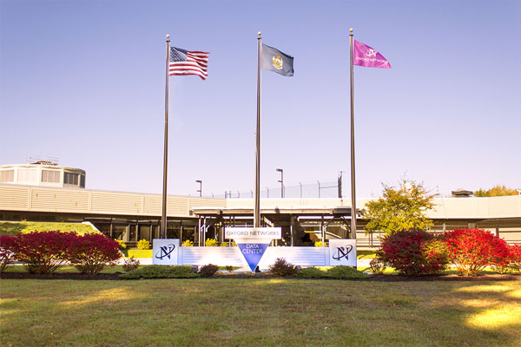
Report Summary
Data Center Solutions
3 out of 4 Companies
at Risk
36% of organizations lost critical applications, VMs or data files for hours
1 in 5 lost one or more for a period of days
1 in 4 lost most or all of their datacenter for hours or days
Reported losses ranged from a few thousand to millions of dollars
20% indicated losses of more than $50,000 to over $5 million
©2015 BY OXFORD NETWORKS

Slide 5
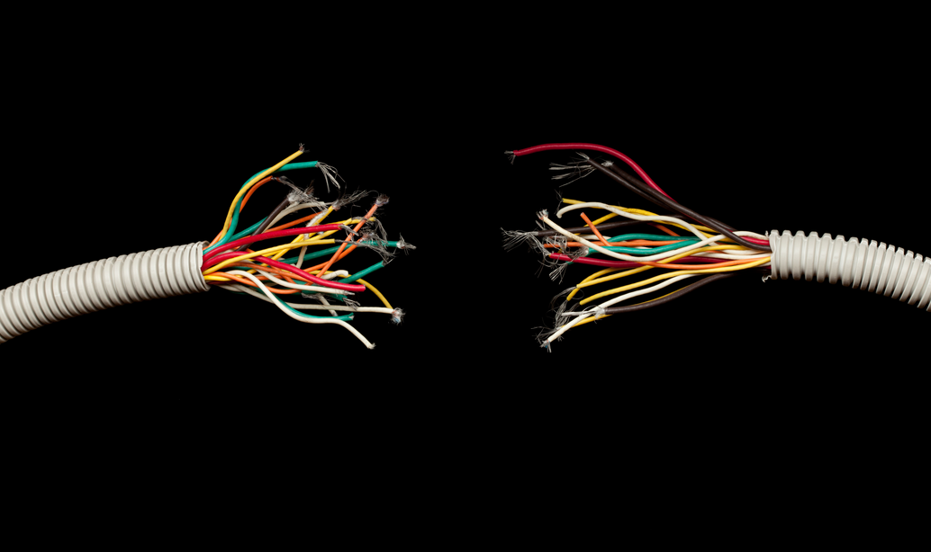
Outages Happen
Data Center Solutions
Over Half Lost Critical Apps or Entire Data Center
©2015 BY OXFORD NETWORKS

Slide 6
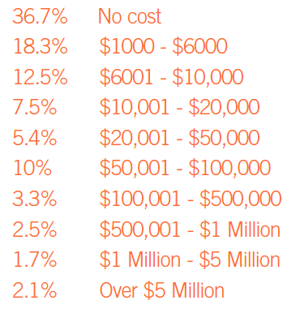
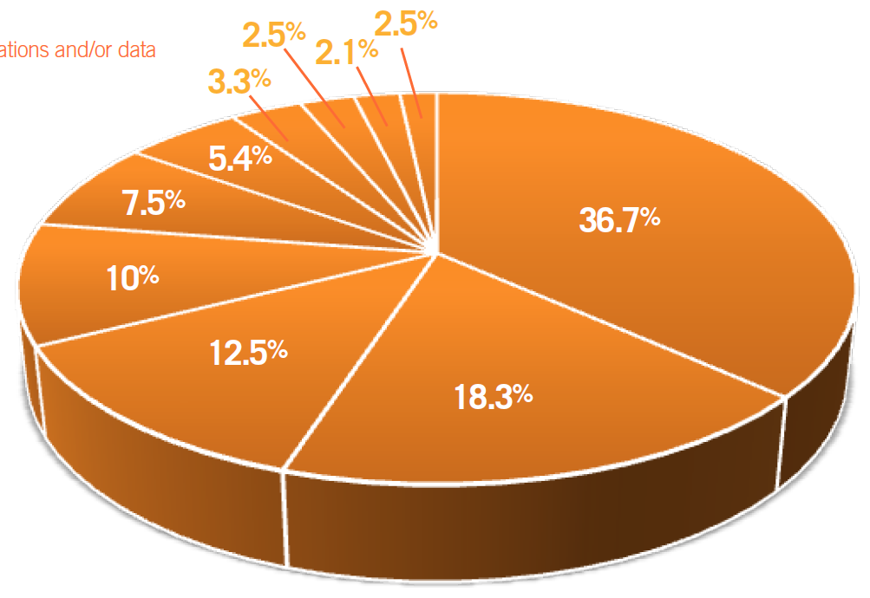
And They Can Be Expensive
Data Center Solutions
20% lost over $50,000
©2015 BY OXFORD NETWORKS

Slide 7
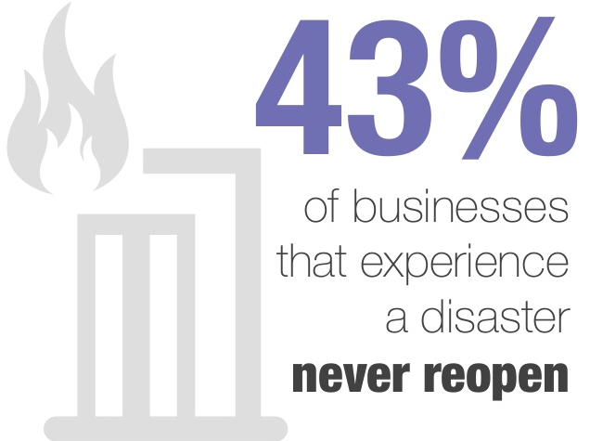
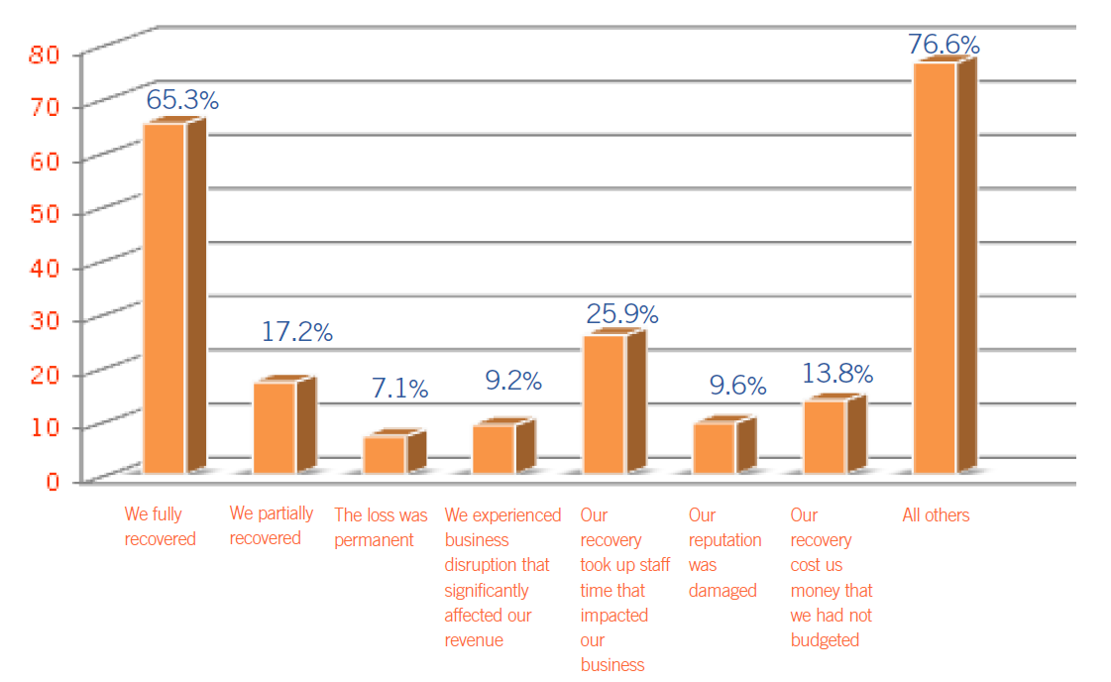
Business Impact can be Significant
Data Center Solutions
Or Permanent
Financial Loss
Reputation
Staff Time
Lost Data
©2015 BY OXFORD NETWORKS

Slide 8
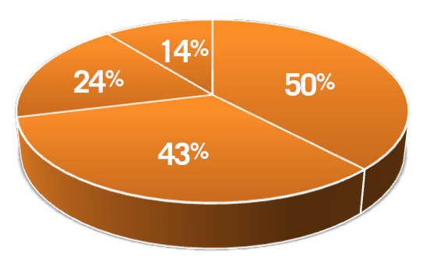
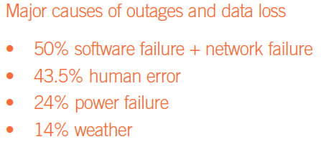
Outage/Data Loss Causes
Data Center Solutions
Software, Hardware, People
©2015 BY OXFORD NETWORKS

Slide 9
Report Summary
Data Center Solutions
The Culprits
Lack of Documentation
60%+ did NOT have a fully documented DR Plan
40% admitted the DR Plan they do have was not very useful
Lack of DR Testing
1/3 test once or twice a year
23% never test
When they do test
65% fail their own tests
©2015 BY OXFORD NETWORKS

Slide 10
Lack of DR Planning
Data Center Solutions
Clearly a Sore Spot
©2015 BY OXFORD NETWORKS

Slide 11
Report Summary
Data Center Solutions
Positives
Some Organizations are Prepared
27% Received Passing Grades
65% Experienced a Disaster and Fully Recovered
Majority have invested in a Secondary Site
DR Best Practices are being identified including:
Detailed DR Plans
DR Metrics
DR Testing
©2015 BY OXFORD NETWORKS

Slide 12
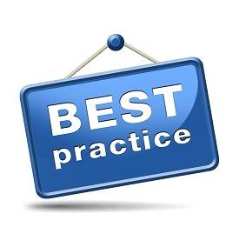
DR Best Practices
Data Center Solutions
Developing a DR Solution
Risk Assessment & Inventory
Recovery Objectives
DR Plan Development
Documentation
Testing
Secondary Site Options
On-premises
Colocation
Hosted
©2015 BY OXFORD NETWORKS

Slide 13
Inventory & Risk Assessment
Data Center Solutions
Identify Assets to Identify Risk
Inventory Corporate IT Assets
Identify Risks and Probabilities Associated with Each Asset
Speak with Potentially Impacted Business Units
Find the Hidden Nuggets
What is the Existing Mitigation Plan?
Backups? Secondary Site? None?
©2015 BY OXFORD NETWORKS

Slide 14
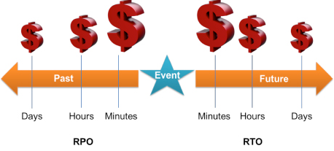
Recovery Objectives
Data Center Solutions
Time and Point
Recovery Point Objective - Maximum tolerable period in which data might be lost
Focused on backup frequency
Recovery Time Objective - Target time set for resumption of services
Time required to restore operations
RPO/RTO are critical parameters to define
Always a gap between objectives and actuals (RPA/RTA)
©2015 BY OXFORD NETWORKS

Slide 15
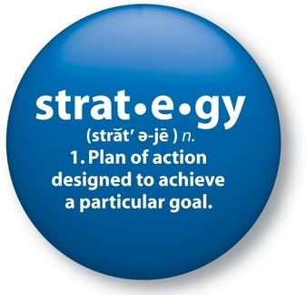
DR Strategy
Data Center Solutions
What’s The Plan?
Define the approaches to implement required resiliency
No silver bullet - every organization is unique
Influenced by many factors:
Budget & Skill Set
Physical Facilities
Existing Policies & Procedures
Align expectations with reality
©2015 BY OXFORD NETWORKS

Slide 16
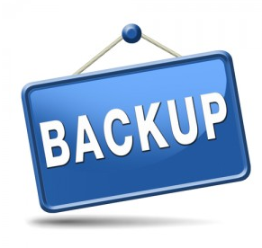
Backups and Replication
Data Center Solutions
Data Backups
Application and data remain on-premises, data backed up to secondary location
Replaces off-site tape backups
Provides geographic separation
Replication
Protects both data and VMs
Addresses aggressive RPO/RTOs
More likely to support application consistent recovery
Requires replication software/appliances
©2015 BY OXFORD NETWORKS

Slide 17
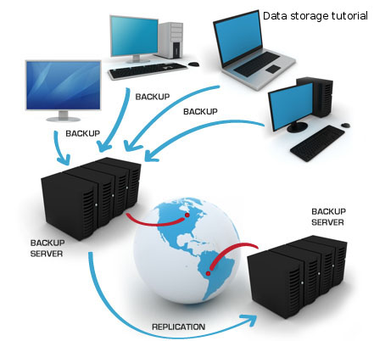
Cloud-Based Backups
Data Center Solutions
Applicable When:
Automatic execution and replication of backups
Multiple sites available
Eliminates cost of secondary sites
Avoids CAPEX costs
Benefits:
Affordable pay-per-use pricing models
Anytime, anywhere access
Simplified Interfaces
Lower overall DR costs
Cost effective long term storage options available
©2015 BY OXFORD NETWORKS

Slide 18
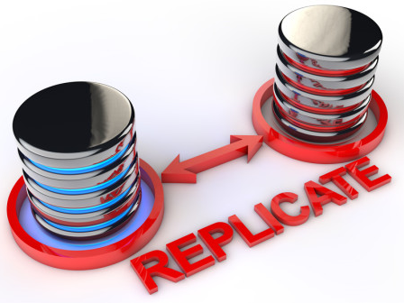
Secondary Sites
Data Center Solutions
Multiple Options
On-Premises Backup and Disaster Recovery Services
Colocation Facilities
Public Clouds
Disaster Recovery as a Service (DRaaS)
©2015 BY OXFORD NETWORKS

Slide 19
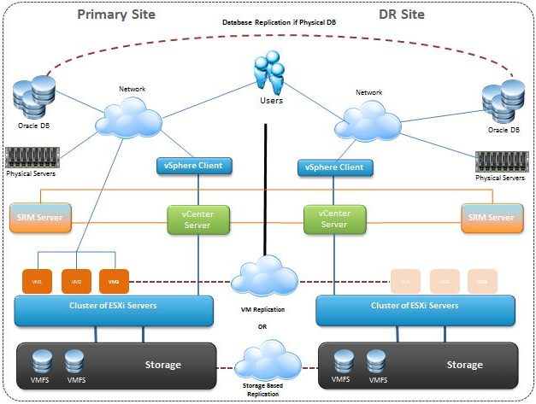
On-Premises
Data Center Solutions
Retain Full Control
Applicable When:
Want to use your own data center
Plan to use storage array-based replication
Synchronous Replication
RPO < 15 Minutes
Benefits:
Centralized recovery plans
Non-disruptive Testing
Automated Failover/Failback
Planned site migrations
©2015 BY OXFORD NETWORKS

Slide 20
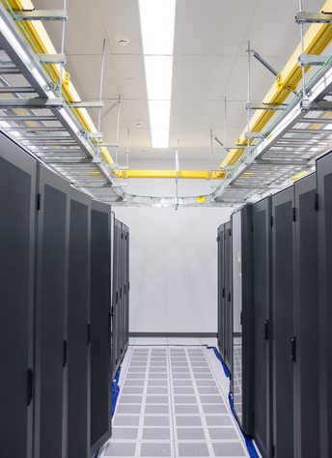
Colocation
Data Center Solutions
Full Control
Secondary Data Center
Applicable When:
You need to ‘add’ another data center
Retain full control of hardware and software
Need to offload the infrastructure
Remote hands may be needed
Benefits:
Reduced overhead
Redundant cooling/power
Physical separation from primary location
Increased physical security
©2015 BY OXFORD NETWORKS

Slide 21
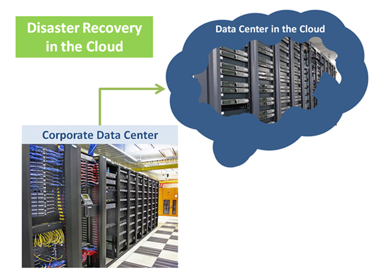
Cloud-Based Disaster Recovery
Data Center Solutions
Applicable When:
Maintains complete control of on-premises environment
Uses Public Cloud as targeted DR
Eliminates cost of secondary sites
Avoids CAPEX costs
Benefits:
Pay-per-use pricing model
Expenses covered through operating budget
Economies of scale
Lower overall DR costs
©2015 BY OXFORD NETWORKS

Slide 22
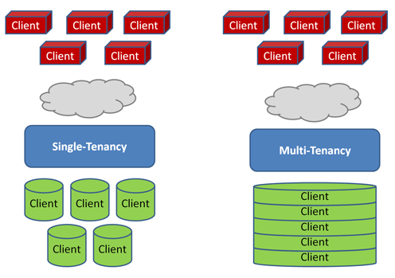
Cloud Tenancy
Data Center Solutions
Multi-tenant:
Multiple companies share same applications and infrastructure
Instances partitioned to protect and isolate company data
Less customizable/
Single-Tenant:
Each company has isolated application and supporting infrastructure
Easier regulatory compliance
Dedicated resources are generally more expensive
©2015 BY OXFORD NETWORKS

Slide 23
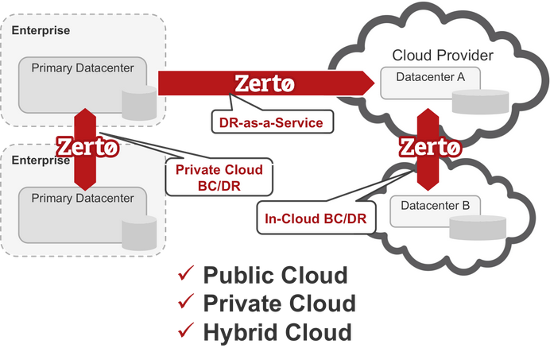
Disaster Recovery as a Service
Data Center Solutions
Applicable When:
Rapid and Immediate Recovery
Flexible Solution
Eliminate Cost of Secondary Sites
Relatively Homogenous Environment
Benefits:
Reduced Pay-per-use Pricing Model
Economies of Scale Benefits
Lower Overall DR Costs
Simplified Testing Procedures
©2015 BY OXFORD NETWORKS

Slide 24
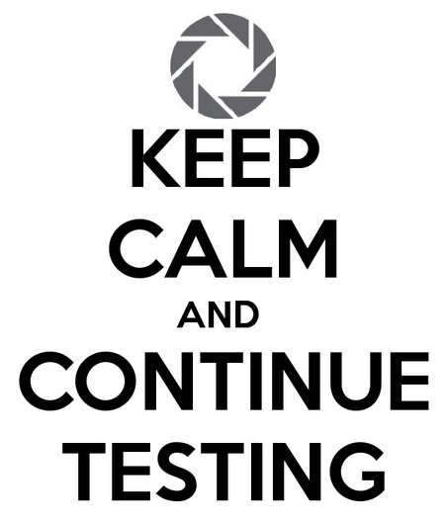
Testing
Data Center Solutions
This is a Must!!
First – Have a Test Plan
Set schedule, gather resources
Test Data, Scripts – automate where possible
Ensure documentation availability in secondary locations
Goal is to test both RTO and RPO under a controlled environment
Involve Key Users to Verify Application Level functionality
Always conduct Post-Mortems
©2015 BY OXFORD NETWORKS

Slide 25
Various Testing Approaches
Data Center Solutions
Walkthrough Test – verbal rehearsal of each step of plan
Good first step, identifies glaring gaps
Quickest, cheapest and least thorough
Simulation Test – full rehearsal
Test all procedures, verify backup/recovery operations
Don’t forget to add in voice and data communications
Parallel Test – process historical transactions against preceding day’s backups
Can be performed in conjunction with Walkthrough/Simulation Tests
Full Interruption Test
Most realistic and most costly
Can/will impact normal operations so plan accordingly
Take copious notes
©2015 BY OXFORD NETWORKS

Slide 26
Additional DR Requirements
Data Center Solutions
Data, Systems and Applications are only part of the equation
Can your organization continue to function in the event of a disaster?
• Available Workspace
• Phone Lines
• Network Connections
©2015 BY OXFORD NETWORKS

Slide 27
So Many Options…
Data Center Solutions
…To name just a few
©2015 BY OXFORD NETWORKS

Slide 28
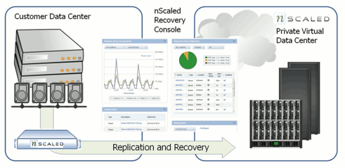
Acronis DRaaS
Data Center Solutions
Complete IT Continuity Solutions:
Guaranteed, flexible RTO - up to 15 minutes or less per server
Automated testing - allows you to regularly test all of your protected servers in a virtual private 'sandbox' environment
Full visibility and control - with self-service Web-based recovery console allowing you to manage your entire DR environment
White glove support - team of experts available 24/7 to assist with failover and failback
Choice of platforms - physical or virtual, any hypervisor, any storage
©2015 BY OXFORD NETWORKS

Slide 29
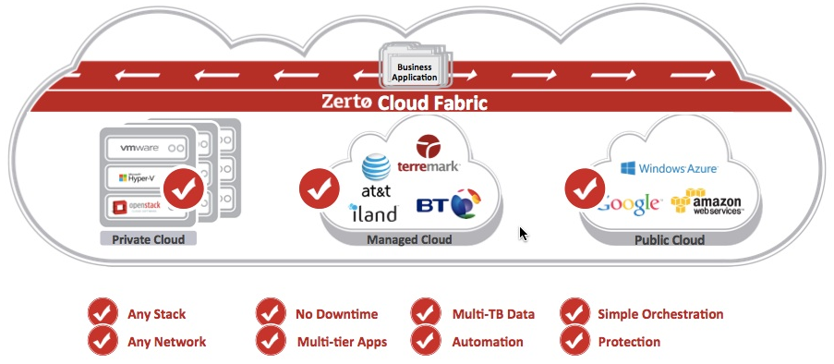
Zerto
Data Center Solutions
Software only, Hardware agnostic
Failover testing in a single click
Replicate and Protect a VM in VMWare vSphere vCenter with a few clicks
Fully automates the entire failover and failback process
Uses continuous replication vs snapshots
Virtual Protection Groups protect an entire application spanning multiple VMs with a single policy and a single automated failover and failback process.
No changes required to your storage or server infrastructure
©2015 BY OXFORD NETWORKS

Slide 30
Questions?
Report Overview
DR Plan Development
Secondary Sites & Solutions

