Slide 1
Marketing to Millennials:
What You Need to Know
Meredith J. Deen, President
1720 Windward Concourse #200 Alpharetta, GA 30005 | Tel: 770.619.3443 | www.fmsi.com

Slide 2
About FMSI
Established in 1990
Based in Alpharetta, GA
Omnix Suite of Products:
Performance Analytics
Staff Scheduler
Lobby Tracker
Appointment Concierge
Publish between 3 & 6 Industry Studies per Year
Serving 200+ Financial Institutions

Slide 3
Agenda
Key Characteristics of Millennials
Millennials as Customers
Key Statistics
Specific Strategies
Millennials as Employees
Key Statistics
Specific Strategies

Slide 4
Key Millennial Characteristics
At least as large as the Baby Boomers
Most diverse in US History
They are starting to reach their 30s, a time common for financial decisions
Growing up in the internet age, they crave information in easy to consume ways
They expect personalized communication
Technology is a must
81
Million
Born between 1982 and 2000

Slide 5
Millennials as customers

Slide 6
Meaningful Statistics – Millennial Customers
58% Are interested or very interested in proactive financial recommendations
10% More Millennials need assistance making a buying decision than any other group
Millennials are 30% more likely to bank on their mobile devices
If they can engage the company on social media, 62% are more likely to be loyal to the brand
73%
Prefer
Alternate Financial Channels
Sources: Viacom Media, Accenture, Deloitte, TimeTrade

Slide 7
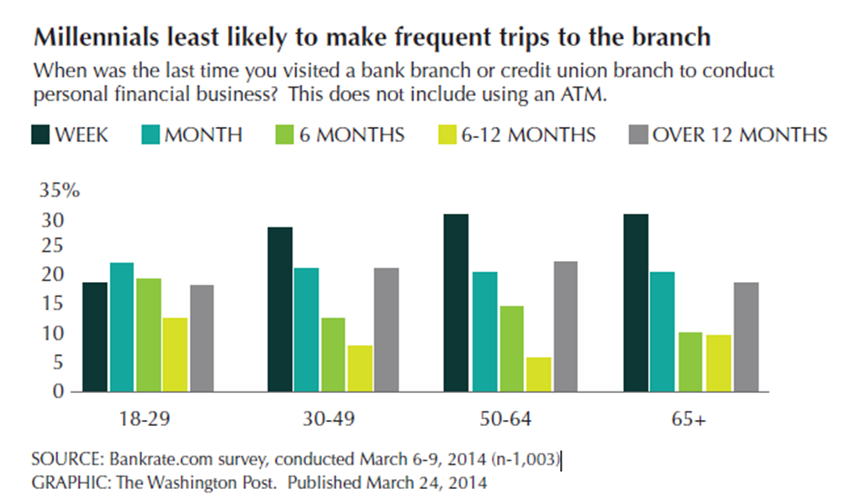
Meaningful Statistics – Millennial Customers
Sources: Viacom Media

Slide 8
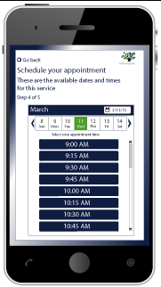
Specific Strategies – Millennial Customers
Cater information in a personalized, informative way – include gamification and make it free
Make it easy to come to the branch – implement an appointment setting solution so they can pick the time from your website to visit a branch

Slide 9
Specific Strategies – Millennial Customers
Go high tech/high touch in your branches
Let them know what to expect with regard to wait-times
Enable them to gather information from technology while they wait
Ensure your team is knowledgeable
Marketing should be limited on text, think videos and graphic heavy content
Enable the customer to define the preferred method of communication

Slide 10
Millennials as employees

Slide 11
Meaningful Statistics – Millennial Employees
The largest workforce in 2015
39% of Millennials have had difficulty finding a “traditional” job
53% of Hiring Managers say “Hiring Millennials is Difficult”
6 in 10
Chose Where to Work for
Sense of Purpose
Sources: Deloitte, The 2015 Millennial Majority Workforce Study

Slide 12
Meaningful Statistics – Millennial Employees
Sources: Elance/Odesk, 2015 Millennial Majority Workforce Study

Slide 13
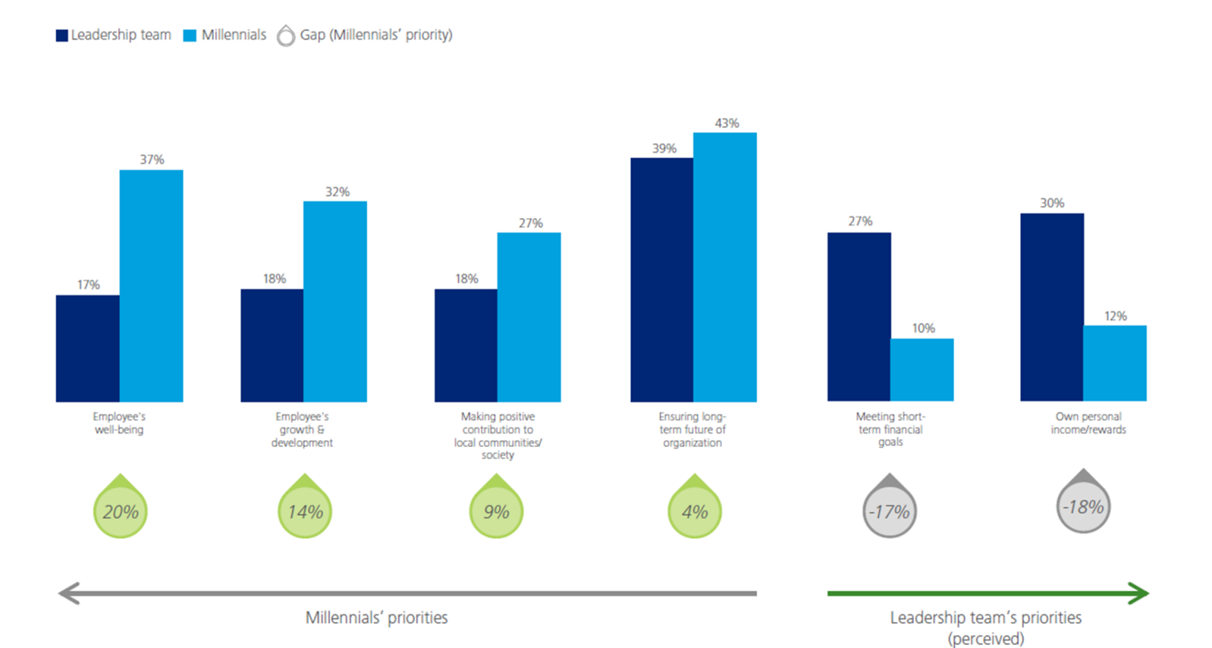
Meaningful Statistics – Millennial Employees
Sources: Deloitte

Slide 14
Meaningful Statistics – Millennial Employees
Millennials Believe Technology Companies Have the Strongest Leadership
Sources: Deloitte

Slide 15
Specific Strategies – Millennial Employees
Develop professional development and job growth programs versus “training programs”
Provide opportunity for advancement
Make a Millennial your hiring manager
Educate Generation X employees to embrace Millennial qualities
Use technology to ensure they have flexibility in their work schedules
Enable blending of work life and home life

Slide 16
FMSI
Located in Atlanta, GA and established in 1990, FMSI provides easy-to-use, yet sophisticated, software-as-a-service solutions—Omnix Staff Scheduler™, Omnix Interactive Dashboard™, Omnix Performance Analytics™, Omnix Lobby Tracker™, and Omnix Appointment Concierge™ — that allow FIs to manage and staff to meet their service and sales needs.
For more information, contact Sales at 877.887.3022 or sales@fmsi.com.
Download all FMSI white papers and recorded webinars at www.fmsi.com/resources

