Slide 1
“Integration is Essential for Financial Institutions to Prosper “
Bank Horizons December 2nd 2015 concurrent session 11:30 to 12:15
Mark J. Cvrkel
Senior Bank Advisor, The Galbreath Group
mcvrkel@thegalbreathgroup.com / 610-213-8307 cell
Notes:
Welcome . . .

Slide 2
Outline for Discussion:
A little Background
Some of the Problems
Integration Vision
Example of Completed Analysis
Conclusion
Questions?

Slide 3
Bank’s History
The organization consisted of 9 separate and distinct banks
Consolidated into 3 Banks
Consolidated to one bank, but still had THREE DISTINCT REGIONS (remained a silo)

Slide 4
Problems:
INCONSISTENT Reporting
INCONSISTENT Profitability Measurement
INCONSISTENT Risk Assessment
A SILO APPROACH TO INFORMATION MANAGEMENT

Slide 5
GOALS
Establish a process which:
Outlines a Framework for Risk-Based Pricing
Measures Profitability
Customer
Product
Organization Structure
Integrated
Forward Looking (planning process will be based on profitability contribution & risk metrics)

Slide 6
Steps toward accomplishing goals
Integrate ALCO and Planning process
Re-evaluate Credit Risk Management process:
Less subjective
Account for concentration risk
Maturity and Term structure impacts
Correlation between similar borrowers & default
Profitability must be a forward looking measurement

Slide 7
INTEGRATION

Slide 8
Scorecard
ALM
GOALS
Stress Testing
Economic Capital
Profitability
Planning Process
Notes:
8

Slide 9
ALM
Projected Cash flows
Prepayment Assumptions
Sensitivity Analysis
Liquidity What-If
MVPE (Market Value of Portfolio Equity)

Slide 10
Risk Ratings (Probability of Default - PD)
Facility Rating (Loss Given Default – LGD)
Undrawn Lines (Exposure at Default – EAD)
Add’l Factors: Correlation, Concentration Risk, Diversification benefit, & Term Structure (not covered under regulatory capital measurement)
Scorecard
Baseline, adverse, & severely adverse scenarios:
Real GDP
Unemployment
CPI
Interest rates
CRE price index
Stress Testing

Slide 11
Expected Loss Calculation:
Expected losses (EL) ($) = PD (%) * LGD (%) * EAD ($)
i.e. risk weighted 5 credit for $100,000 loan:
PD=0.50%
LGD=40%
0.50% * 40%* $100,000= $200

Slide 12
BUFFER
RISKS:
Market Risk
Operation Risk
Interest Rate Risk
Credit Risk
Economic Capital*
*capital needed to cover unexpected losses

Slide 13
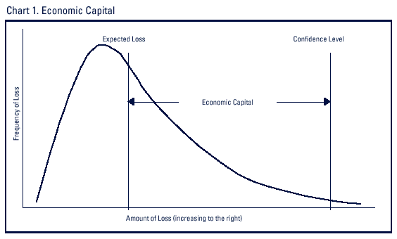
Economic Capital (economic capital addresses all risks from the bank’s business activities)

Slide 14
Instrument Level
Customer Level
Product Level
Region Level
Division Level
Profitability

Slide 15
Strategic Outlook
Annual Plan
Rolling 24 Month Outlook
Spread & Return Driven
Planning Process

Slide 16
GOAL
Framework for Pricing (Relationship)
Performance Measurement
Tool for establishing risk appetite
Incentive Compensation
RAROC (Risk Adjusted Return on Capital)
Notes:
16

Slide 17
Scorecard
ALM
GOALS
Stress Testing
Economic Capital
Profitability
Planning Process
Notes:
17

Slide 18
EXAMPLE

Slide 19
Example of the process:
Region 1
Business / Commercial loans
1201 customers
Total outstanding balance of $750MM
Average customer balance of $630K
Largest customer balance of $28MM
Target hurdle rate 10%

Slide 20
Commercial and Industrial segment has a Risk-Adjusted Return on Capital (RAROC) of 20.7%
Customers in (A) are highly profitable and provide good margins on their loans
Customers in (B) give minimal economic profit but add to loan volume
Customers in (C) are destroying value and should be re-priced or avoided

Slide 21
RAROC as a standard unit on the customer level to measure profitability
Funds Transfer Pricing
Risk
Net Income (Margin)
Interest Income
Cost of Funding
Fee Income
Expected Loss
Risk Rating
PD
Risk/Reward Trade-Off
LGD
Reward
Operational Costs
Cost Allocation
Cost of Capital
Economic Capital
Taxes
Economic Profit *
Margin
–
Operational Costs
–
Expected Loss
–
Taxes
RAROC =
Economic Capital
* Economic profit of $0 is required to meet hurdle, which is equivalent to a RAROC of 10%

Slide 22
High risk customers can be priced with a higher margin to compensate for the risk
High Reward/Low Risk
Low Reward/Low Risk
High Risk/
High Reward
Low Reward/ Low risk
* Interest income includes funds sold and bought
** Cost of funds adjusted for economic capital

Slide 23
High leverage, low profitability, and slow growth contributed to increased risk
Customer 5 – Risk Rating 14
Customer 6 – Risk Rating 7

Slide 24
Pricing levers can be used to increase profitability of customer

Slide 25
Targeting low-risk customers allows the bank to price more competitively relative to market

Slide 26
Thoughts:
Do not underestimate the time frame to implement the scorecard project
A scorecard approach will aid in the implementation of FASB Current Expected Credit Loss Impairment Model (CECL)
Do not underestimate required IT resources including a dedicated person
Scorecard progress will be hindered by incomplete source data in loan system and lack of dedicated project team (CECL issue also)
It will be a Management Challenge adjusting from volume-driven perspective to profitability perspective

Slide 27
Regulator Perspective
Continued regulatory pressure will be the norm “ALL BANKS”
Capital will need to be allocated by product line (dual approach)
Management and Board will need to set risk appetite even at smaller institutions
Provisioning will be data driven and forward looking (CECL)
M&A activity will increase

Slide 28
Pricing to the Competition
Be willing to walk
Understand the competition
Never lower pricing spreads without gaining something for your organization
You are building long term relationships - customers understand that you need to make MONEY
You will not win all the deals
KEEP IT SIMPLE

Slide 29
QUESTIONS?

