Slide 1
Mid-Year Mortgage Conference and Expo FHA Update Hilton Boston-Woburn: Woburn, Massachusetts June 24, 2015
Presenter:
Michael Levine
Housing Program Officer, Office of Single Family Housing
U.S. Department of Housing and Urban Development

Slide 2
Today’s Presentation
FHA Loan Affordability: Features that make an FHA loan affordable, a historic vehicle for access to credit.
FHA Update: What HUD is doing to address three Single Family priorities:
Expanding Access to Credit
Ensuring Long Term Viability of MMI Fund
Making it Easier to Do Business with FHA

Slide 3
FHA Single Family Priorities
Expanding Access to Credit
Ensure Long-term Viability of MMI Fund
Implementing responsible ways of providing first-time homebuyers and underserved, credit worthy borrowers access to credit to ensure long-term homeownership success.
Balancing our mission with sound lending practices to ensure the health of the Mutual Mortgage Insurance Fund.
Making it Easier to Do Business
Working with the industry participants to enhance business processes, communication, and policy clarity.
Notes:
Expanding Access to Credit
__ Expanding Use of Housing Counseling
Single Family Housing Policy Handbook
Quality Assurance Framework
Ensuring Long-term Viability of the MMI Fund
Making it Easier to Do Business with FHA
Strategies for Moving Forward
Electronic Appraisal Delivery Portal

Slide 4
FHA Affordability: Providing Access to Credit for Many Families and Purposes
Features that make FHA the current choice of many
first-time homebuyers and those with special needs.

Slide 5
Affordable Features of FHA Loans
Down payment requirement: Only 3.5 percent.
Government secondary financing or a gift from family or one’s employer can cover 3.5 percent.
Streamline Refinance opportunity.
Permit Non-Occupying Co-borrower.
Competitive interest rate.
Assumable.
Permanent requirement that lenders help borrowers avoid foreclosure.
5

Slide 6
FHA Affordable Housing Opportunities in Massachusetts
Low down payment home loans with flexible low-cost terms.
203(k): Purchase or Refinance and Renovate with one home loan.
Reverse Mortgages Help Seniors’ Finances.
Combine FHA with HFA or local government funds for down payment and closing cost assistance.
Opportunities to purchase HUD homes.
6

Slide 7
203(k) – Purchase or Refinance with Rehabilitation
Purchase and rehabilitate with one low cost loan.
Renovation funds are escrowed so work can be done after closing.
Modernize, add rooms, new heating or roof, energy improvements, anything that’s needed.
Limited 203(k) for non-structural work up to $35,000; no consultant required.
Loan amount is based on as-rehabilitated value.
7

Slide 8
Recent HECM Changes
FHA now places more restrictions on the amount that can be drawn down at closing and during the first 12 months. This will help many seniors maintain sufficient funds over the life of the loan.
For HECM cases issued after 8/14/14:
A Non-Borrowing Spouse of a deceased HECM borrower, who was married to the borrower when the loan was closed, may remain in the property as long as other HECM loan terms are satisfied.
HUD rescinded a Mortgagee Letter addressing similar concerns for HECMs issued before 8/14/14 but extended deadlines 60 days pending further policy review.
8

Slide 9
Recent HECM Changes (cont.)
For HECM cases issued after 4/27/15, FHA requires a financial assessment to:
Evaluate whether a Life Expectancy Set Aside (LESA) account is required for payment of property taxes and hazard and flood insurance premiums and whether the LESA must be partially or fully funded.
Whether the HECM is a sustainable solution for the borrower.
9

Slide 10
Combining FHA with Affordable
Seconds or Gifts
HFA, local government, family, or employer may cover down payment but employer may not restrict employment as a condition.
Other parties can cover closing costs and POCs but not included in down payment calculations.
No combined LTV Restriction on Purchase with FHA and non-amortizing Government second loan.
Resale restrictions must dissolve upon foreclosure.
10

Slide 11
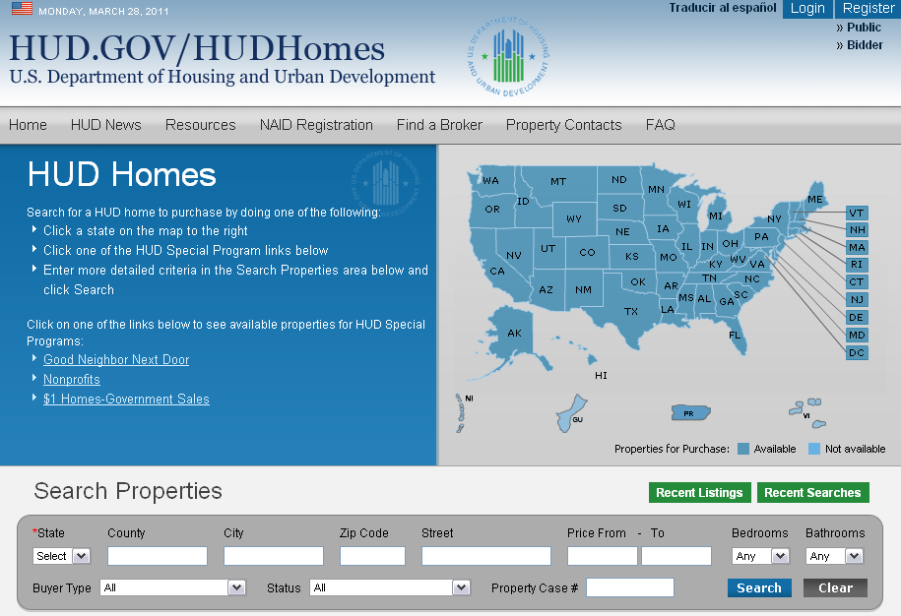
Buying a HUD Home: www.hudhomestore.com
Text
11
Notes:
One web site for the entire country . . .
Purchasers see what brokers see . . .
New format with enhanced features . . .
HUD’s Asset Management contractors now have the ability to list properties on a daily basis instead of once a week.
One stop shopping to view properties nationwide, submit bids and obtain forms

Slide 12
Increased Affordability Translates into Increased Access to Credit - ½ Percentage Point Reduction in the Annual MIP Premium…..
Saves $900 annually for an average household.¹
Benefits 2-3 million households over the next 3 years.
Saves $2-$3 billion for these households.
Nearly 250,000 additional creditworthy, responsible families will be able to afford to buy over the next 3 years.
Based on average loan size of $180,000
Based on average loan size of $180,000
Revised for ML Presentation: 4/24/15
Source: HUD
Notes:
On January 8th, the President Obama announced that FHA reduced its Annual mortgage insurance premiums for most fixed-rate products.
This was GREAT news because while in many markets, home prices have recovered, and fewer homeowners are underwater, the costs of obtaining the American Dream is still too high for a lot of working families.
FHA took action and reduced its Annual premiums by half a percentage point (i.e., 0.5 percentage points from 1.35 to 0.85). A responsible reduction in premiums will allow FHA to remain on a strong financial trajectory while reducing the cost burden on borrowers
The lowered MIP makes homeownership more affordable and increases access to credit for more responsible home buying individuals and families. This reduction of half a percent will save FHA borrowers an average of $900 per year, benefiting an estimated 2-3 million families over the next three years, including a quarter million new homebuyers who will now be able to afford a loan
This measured reduction was possible because FHA’s MMI Fund is Back in the Black and we have worked hard to strengthen our own finances to ensure we can serve future generations as we will discuss later.
.
Clearly, this premium reduction is a win all around — for qualified borrowers, for the overall economy and for FHA’s finances because we’ll have more responsible folks in our portfolio.
When done right, homeownership generates a wide-variety of benefits to our nation.
And in taking this step, FHA will continue its unique role in making the dream of homeownership available to a wide-range of responsible Americans — including those often overlooked and forgotten.

Slide 13
Expanding Access to Credit
Responsibly providing first-time homebuyers and underserved, credit worthy borrowers access to credit to ensure long-term homeownership success through:
Housing Counseling
Single Family Housing Policy Handbook
Quality Assurance Framework

Slide 14
FHA Purchases and Access to Credit
FHA Share of Portfolio: First-Time Homebuyers
Source: FHA Home Mortgage Insurance Division
14
Notes:
Speaker Note Guidance
Before we get deeper in the conversation of our planned activities, I first want to take a brief look at one set of market data we are seeing to frame the discussion
This is a brief snapshot or our purchase volume over the past five years. While we could spend more than the entire discussion on the many factors that are driving FHA business, some of the overarching factors include:
The continued improvement in non-government backed mortgage participation which typically serves the non first-time homebuyer market
Continued improvement in the overall economy
Interest rate fluctuations
Last but not least, the cost of obtaining an FHA insured loan.
These factors have lead the way for FHA’s market participation to return to a more normal role--providing access to credit for underserved borrowers, especially first-time homebuyers.
FHA is Back in the Black. And with the MMI Fund on a strong and positive trajectory, FHA is even more focused on addressing the uneven housing recovery through our Blueprint for Access, which targets these borrowers.

Slide 15
Housing Counseling Services
Pre-purchase Counseling
Homelessness
Post-Purchase
Reverse Mortgage
Mortgage Delinquency and Default
Financial Management
Group Education
Housing Counseling
Services Offered
HUD has national network of approximately 2,200 HUD-approved housing counseling agencies, and provides oversight
Reviews and approves each agency
Monitors compliance with HUD regulations and conducts performance reviews
Oversees independence, conflicts of interest, content and process standards
Provides organizational, financial support, technical assistance and training
Provides services in a variety of ways
Phone counseling
Skype
Internet Counseling/On-line
In person
22 different languages
Offer tools and resources
down payment assistance
food banks/emergency utility assistance
job/interview training
daycare
homeless shelters
Core Competencies
Financial Management
Property Maintenance
Responsibilities of homeownership and tenancy
Fair housing laws and requirements
Housing affordability
Avoidance of, and responses to, rental and mortgage delinquency and avoidance of eviction and mortgage default
Notes:
Housing counseling is an important aspect to expanding access to credit because it strengthens homeownership readiness of prospective borrowers and helps troubled borrowers retain their homes. HUD has an Office of Housing Counseling, provides housing counseling grants, certifies Housing Counseling Agencies, and promotes housing counseling FHA insured and other borrowers.

Slide 16
Housing Counseling Benefits
Consumer Benefits
Provides unbiased assistance to help clients resolve their housing problems or needs.
Provides one-on-one counseling and housing education.
Helps clients assess readiness for homeownership and the responsibilities.
Provides an action plan to clients to address barriers to housing and monitors progress.
Helps clients to access community resources that improve quality of life.
Helps clients improve borrower risk profile increase savings, reduce debts, and increase disposable income.
Assists client with delinquent payments to work with lenders.
Industry Benefits
Diverts inappropriate applicants from homeownership by helping them assess readiness and responsibilities.
Identifies “ready” applicants who may not be reached by traditional marketing efforts
Increases consumer confidence in traditional banking.
Provides a second look program for applicants who are denied loans
Confirms adequacy of fair housing and fair lending protocols.
Provides market intelligence on potential borrowers and renters and insight on why “seemingly qualified” persons are self-selecting out.
Notes:
Housing Counseling before purchase has been shown to reduce the potential for default and foreclosure by up to one third. It benefits mortgage and real estate professionals by generating increased approvals, filtering out applicants who are not ready, increasing customer satisfaction, generating repeat business, and creating opportunities for partnership with non profits and State Agencies that are sources to expand your customer base.

Slide 17
Single Family Housing Policy Handbook (HUD Handbook 4000.1)
FHA’s Single Family Housing Policy Handbook (SF Handbook) is a comprehensive, single source for FHA Single Family Housing Policy:
As of March 18, 2015, consolidated over 225 existing Handbooks, Mortgagee Letters and other policy documents into one source.
Supports FHA’s Access to Credit strategies.
Makes it easier for mortgagees, lenders, and other stakeholders to do business with us.
Notes:
Speaker Note Guidance:
On October 29, 2013, Single Family Housing posted for feedback the first draft section of the future Single Family Housing Policy Handbook (SF Handbook), Application through Endorsement for Title II Forward Mortgages (Application through Endorsement). Since this time, FHA has published other sections and sub-sections of the SF Handbook, reinforcing our goal to develop a comprehensive, single source of FHA Single Family Housing Policy.
As of March 18, we’ve consolidated over 225 existing Handbooks, Mortgagee Letters, Housing Notices, Guides and other policy documents into this single source document. On its effective date, these mortgagee letters become superseded in whole or in part by the SF Handbook.
The SF Handbook supports FHA’s Access to Credit strategies and the goal of making it easier for lenders, mortgagees, and other stakeholders to do business with us.

Slide 18
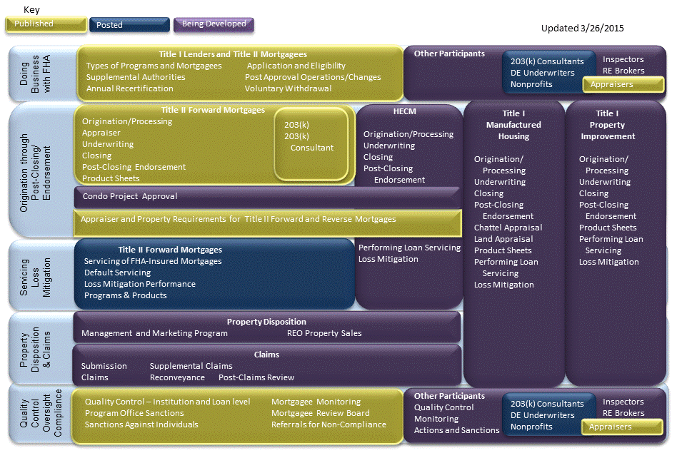
Single Family Housing Policy Handbook Development Progress
Notes:
Speaker Note Guidance:
This is where we’re at with the development of the SF Handbook.
In gold, are sections that have been published and consolidated into a single source. For Title II Forward Mortgages, a lending entity has just about everything it needs to become an FHA-approved mortgagee, to originate, process, underwrite and obtain an FHA insurance endorsement on almost all Title II forward products and programs, and understand and apply quality control practices on both its business practices and its originations.
We still have a lot of work to do—the sections represented in purple—but these sections are all in progress.

Slide 19
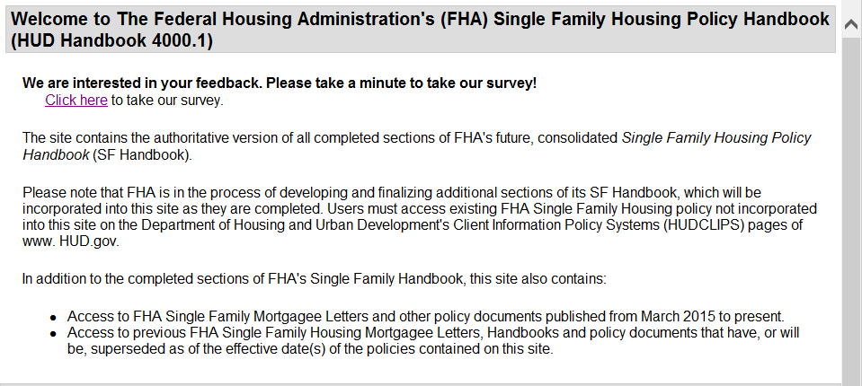
Online, Electronic SF Handbook
Fully searchable, advanced features.
Resides on AllRegs® electronic policy platform.
Free access to site via link on HUDCLIPS.
19
Notes:
Speaker Note Guidance:
FHA launched its online SF Handbook on the AllRegs electronic policy platform on May 18, 2015.
The online SF Handbook resides on an FHA-specific site. If you use the AllRegs commercial site, you’ll have the same type of enhanced functions and features on the new FHA site.
Access to the SF Handbook on the FHA site is free, using a link posted on HUDCLIPS.
FHA will maintain the PDF document of the SF Handbook on HUDCLIPS until September 11, 2015.

Slide 20
Doing Business with FHA
Separate sections for lenders/mortgagees and appraisers were published in March and effective September 14, 2015.
Cover the requirements for doing business with FHA for:
FHA-approved mortgagees
FHA-approved Title I lenders
Appraiser Eligibility and Roster Applications
Revised and consolidated language to achieve clear, direct, and consistent single source for FHA eligibility.
Other subsections for DE Underwriters, inspectors, 203 k consultants, REO real estate brokers etc. in progress.
20
Notes:
Speaker Note Guidance:
THE FIRST PART OF THE HANDBOOK ARE THE REQUIREMENTS FOR BEING APPROVED AND REMAINING IN GOOD STANDING TO DO BUSINESS WITH FHA. WE HAVE POSTED COMPLETED SECTIONS TO TAKE EFFECT ON SEPTEMBER 14 FOR LENDERS AND APPRAISERS
On June 30, 2014, Single Family Housing posted for feedback draft sections of the Single Family Housing Policy Handbook (SF Handbook), Doing Business with FHA—FHA Lenders and Mortgagees (Doing Business) and Quality Control, Oversight and Compliance (Oversight and Compliance) sections.
- After receiving, reviewing and assessing over 550 feedback responses, and clearing the sections though the Single Family and Departmental process; Single Family Housing published the final version of these sections on the new SF Handbook page on HUDClips on March 18, 2015.
The Doing Business with FHA section covers Federal Housing Administration (FHA) approval and eligibility requirements for both Title I lenders and Title II Mortgagees, as well as other FHA program participants.
A Mortgagee must fully comply with all of the approval and eligibility requirements in order to be approved by FHA to participate in all aspects of FHA-insured Title I or Title II Mortgages.
The appraiser sub section contains eligibility requirements to be an FHA Roster Appraiser, and the Appraiser Roster application process.
The overall policy and requirements contained in this sub-section do not include substantive policy changes. However, many changes were made to content and terminology to accomplish the goal of consolidating and conforming policy to a standard format using clear, consistent language

Slide 21
Origination through Endorsement Section
Delivers a consolidated source of policy for all FHA Title II mortgage products and programs.
Essentially complete for Title II Forward Mortgages, except:
REO Purchasing in progress; and
Condominium Project Approval requires formal rule making.
Structure follows traditional mortgage process for FHA 203(b) purchase money mortgage.
Product/program sub-sections contain special rules for specific products and programs, such as 203(k), Energy Efficient Mortgages and Refinances.
Notes:
The heart of our single family handbook are FHA procedures for applying borrower, property and loan eligibility standards in originating, underwriting, closing and endorsing title ii forward loans. . This has been completed for our standard 203(b) loans and 203(k) rehab loans.
After proposing draft sections in October of 2013), we reviewed comments on published the completed version on in September 2014, titled Origination through Post-Closing/Endorsement for Title II Forward Mortgages (Origination through Post-Closing) on the HUD Clips web pages as HUD Handbook 4000.1.
Updates and additions to this section on March 18 :
203(k) Rehabilitation Mortgage Insurance Program
203(k) Consultant requirements
Appraiser and Property Requirements for Title II forward and reverse mortgages
Other sections are in process or require rule making.
Mortgagees and other stakeholders will now have a consolidated source of policy available for origination through obtaining an FHA insurance endorsement for essentially all FHA Title II forward mortgage products and programs.
Effective for FHA Case Numbers assigned on and after June 15, 2015.
The Origination through Endorsement section is designed to follow the traditional mortgage process – for instance, general borrower and property eligibility requirements, then detailed underwriting requirements, documentation requirements, followed by all of the processes to submit and then obtain an FHA endorsement.
IMPORTANT: when you use the SF Handbook, it’s written so that it starts with our base requirements (an FHA 203(b) purchase money mortgage). When you’re originating or underwriting you start with these requirements, but…
If you’re originating one of our special products and programs, you need to go from our base requirements to the product/program sub-section for additional requirements for the specific product or program. They’re not mutually exclusive. You can’t originate or underwrite a 203(k) mortgage by only following the policies in the 203(k) subsection. Nor can you originate a 203(k) mortgage using our base requirements and not adding the additional policies in the 203(k) section.

Slide 22
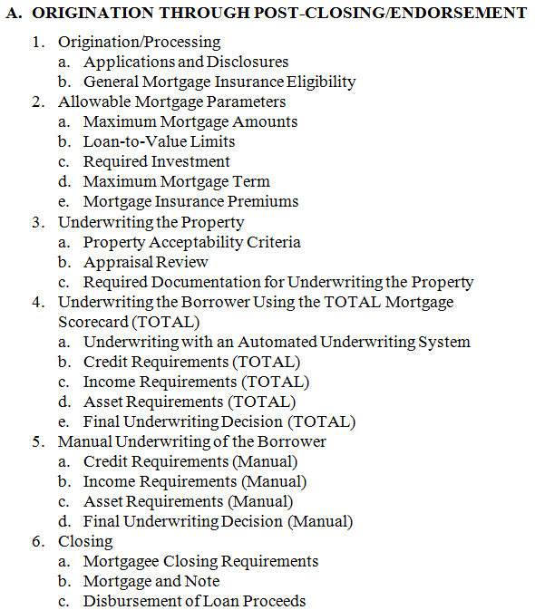
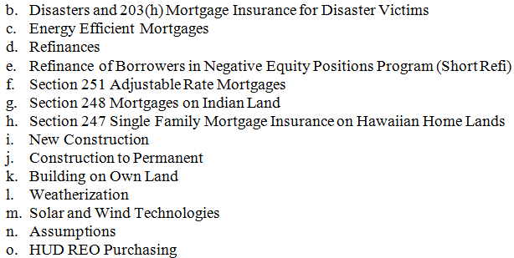
1
2
17
22
Notes:
Speaker Note Guidance:
In this example:
Property Acceptability Criteria for all FHA mortgages (i.e, 203(b) requirements)
Additional property acceptability criteria for Construction to Permanent, if any, are contained in the Construction to Permanent “Product Sheet” sub-section

Slide 23
Appraiser & Property Requirements
Published March 18, 2015; effective for case numbers on and after September 14, 2015.
Covers FHA policies specific to appraiser actions and property eligibility:
Requirements for performing an appraisal
Reporting of Appraisal Results
Links to Single Family Housing Appraisal Report and Data Delivery Guide
23
Notes:
The following appraiser and appraisal-related policies, published on March 18, 2015, work in concert with the appraisal requirements for underwriting in other parts of the SF Handbook’s Origination through Endorsement section:
Appraiser and Property Requirements for Title II Forward and Reverse Mortgages (SF Handbook II.B): This section is the newly published version of the draft policies posted for feedback in July 2014. It contains FHA policies specific to appraiser actions: property eligibility requirements; requirements for appraisers when performing appraisals; and the reporting of appraisal results. The published version of this section also includes:
Further revised language in order to achieve the goal of clear, direct, and consistent language and terminology.
Language implementing policy changes and revisions, as proposed in the draft section posted for feedback in July 2014.
Single Family Housing Appraisal Report and Data Delivery Guide, which is technically not part of the SF Handbook policy document, but works in concert with, and is accessible through hyperlinks from, the Appraiser and Property Requirements section and other sections of Origination through Endorsement. This guide includes all the appraisal report and data format information, and instructions for appraisers to complete, and for mortgagees to deliver, appraisal reports and data to FHA for an FHA-insurable mortgage. Published in March and effective in June, along with the relevant handbook section.

Slide 24
Quality Control, Oversight & Compliance Sections
Portions for mortgagees, lenders and appraisers were published March 18, 2015; effective September 14, 2015.
For Title I Lenders and Title II Mortgagees:
Quality Control Requirements
FHA Monitoring of Mortgagees and Enforcement Actions
For Appraisers: FHA Roster Appraiser Responsibilities.
Subsections on “Quality Control/ Oversight” for other participants, such as inspectors and 203(k) consultants are in progress.
Consolidates existing FHA policy made after 2006 on all mortgagee requirements.
Notes:
Consolidates existing FHA policy made after 2006 on all mortgagee requirements
Guidance streamlined to facilitate ease of compliance w/FHA program requirements
References to internal HUD processes eliminated
Requirements updated to reflect current business processes – i.e., electronic vs. paper based

Slide 25
SF Housing Policy Handbook: Sections Still to Come
Servicing
REO & Claims
Title I
HECM

Slide 26
Quality Assurance Framework
FHA wants to:
Provide clear rules of the road.
Encourage responsible behavior.
So lenders can:
Originate loans with confidence.
Focus on the quality of their processes and lend to all qualified borrowers.
Notes:
Quality Assurance Framework: FHA’s objective is to have a quality assurance (QA) approach that:
Communicates a clear policy message about the importance of abiding by FHA’s underwriting standards and FHA’s willingness to enforce them;
Does not hinder or dissuade lending to FHA-targeted populations;
Facilitates timely feedback to lenders about underwriting quality;
Provides feedback to FHA regarding the effectiveness of its own underwriting policies; and
Applies equally across all FHA lenders; and increases efficiency of enforcement across all stakeholders.

Slide 27
Loan Quality Assessment Methodology (Defect Taxonomy)
I
Identifying a defect
Fundamental characteristics that impact a loan’s insurability, credit quality, and compliance.
Each of these fundamental characteristics would have one defect associated with it.
II
Capturing the sources and causes of the defect
“Defect” composed of one or many sources and causes in loan or loan file or loan file data in TOTAL.
Potential sources and causes of a defect vary by defect type.
III
Assessing the severity of a defect
Severity is assigned to the individual instance of the defect, not to each individual source and cause.
Severity is driven by FHA’s ability to use the information as intended, NOT by the number of defect issues found.
27
Notes:
We are working on strengthening and clarifying our quality assurance reviews for FHA loan.
Currently defects are listed based on the causes of defects and the number of instances found not the nature of the defects,
Defects are addressed with the same sanctions whether a loan is $11 over statutory limit or $1100 over statutory limit.
We also need to improve our communication to the lender as to the sources and causes of the defects so they can address them appropriately.
Proposed new methodology is comprised of 9 proposed defects, specific sources and causes of defects, and up to four defect severity levels. This new approach will improve transparency and consistency for lenders, and provide better data for FHA to monitor the effectiveness of its policies.
Three elements of review:
Identifying a defect.
Capturing the sources and causes of the defect.
Assessing the severity of a defect.

Slide 28
Lender Performance Management
Lender Supplemental Performance Metric will compare lender performance to an FHA risk mix and default rate.
Distribution and SDQ Rates |  |  |  |  |  | Scores
 | <640 | 640-680 | >680 | Weighted SDQ |  | Compare Ratio | Supplemental Metric Ratio
Target
Mix | 25% | 50% | 25% | 1.60%
SDQ | 3.0% | 1.5% | 0.4%
FHA Portfolio
Mix | 9% | 38% | 53% | 1.01%
SDQ | 2.6% | 1.5% | 0.4%
Lender 1
Mix | 30% | 60% | 10% | 1.89% | 187% |  | 118%
SDQ | 2.9% | 1.6% | 0.6%
28
Notes:
Speaker Note Guidance:
The supplemental performance management initiative will provide a broader analysis of a lender’s performance. Lenders are concerned about higher default and claim risks possibly involved in serving creditworthy but difficult to serve borrowers. The new metric will be used in the context of the Credit Watch Termination Initiative to compare lenders’ default and foreclosure rates for the specific risk mix used by a lender as an additional compensating factor. This reflects FHA’s belief that a number of factors are relevant to and indicative of a lender’s performance, and that a lender’s story cannot be summarized by only its Compare Ratio.
This was posted for feedback on our Drafting Table Web page on May 13, 2014; feedback period was open until June 13, 2014:
Received 15 responses: trade associations, lenders, a consulting firm and a think tank
Overall, feedback is very supportive of the measure [but most felt that the proposal would not achieve the intended effect in its current form]
Most common feedback: Need more clarification on how it will be used under the Credit Watch initiative; support for Urban Institute “lender mix-expected SDQ rate” proposal; introduce more FICO buckets and conversely, eliminate credit score bands; and others.
Additional Details
Compares lender performance to a targeted risk mix and default rate, weighting defaults within three different credit score bands. Creates a lender’s weighted average default rate that will be compared to an FHA target rate to derive a Supplemental Performance Metric Score.
The target weighted seriously delinquent (SDQ) rate is initially proposed to be 1.60%, but may be revised on at least an annual basis. If the lender’s Supplemental Metric Performance Score is less than 125% of the target rate, this may be a consideration to not take further action under the Initiative, along with other factors, such as de minimus volumes. Alternatively, if it is equal or greater than 125% of the target rate, that may be a consideration to move forward under the Credit Watch Initiative.

Slide 29
Ensure Long-term Viability
of MMIF
Balancing our mission with sound lending practices to ensure the health of the Mutual Mortgage Insurance Fund.
29
Notes:
Congress requires our insurance fund to be self supporting and to generate a 2 percent capital reserve which is calculated based on a strict standard that anticipates future claims but does not consider income from FHA premiums on anticipated future business.

Slide 30
As a Result of Aggressive Risk Management, FHA’s Fundamental Financial Health will Remain Strong
Past aggressive policy action has put FHA on strong financial footing
30% drop in seriously delinquent rates
58% improvement in recovery rates
63% reduction in foreclosure starts
$7-$10 billion of value added to MMIF every year
$40 billion in available cash for paying claims
The policy changes that produced these results will remain in place and bolster future loan cohorts
Source: FY2014 Actuarial Report, FY2014 FHA Annual Report
30
Notes:
Since last year, the Fund improved $6 Billion, and by $21 Billion over the past two years.
Robust policy actions lead to this result. This includes the increase in loan premiums, which we only partially pulled back with the 50 basis point reduction earlier in our fiscal year, more aggressive loss mitigation (foreclosure prevention) and the changes to the reverse mortgage program.
With the Fund on the right track, FHA is sharpening its focus on facilitating access for creditworthy families.

Slide 31
Making it Easier to Do Business
Working with industry participants to enhance business processes, communication, and policy clarity.
31

Slide 32
Making it Easier to Do Business with FHA
FHA SF Handbook – create a single authoritative source for FHA Single Family policy.
Implement broader use of e-Signature policy.
Business Transformation – implement new capabilities and move some systems to a new technology platform:
Electronic Appraisal Delivery Portal: Improve access to data earlier in the process to improve risk management and to minimize paper.
Lender Electronic Assessment Portal: Enable FHA to better identify, mitigate, and manage risk; automate and replace manual processes.
E-Case Binders – Electronic Appraisal Delivery portal is first step towards a portal enabling lenders to transmit entire case binder to HUD electronically.
Leverage industry data standards where possible (MISMO, etc.)
32
Notes:
Speaker Note Guidance
FHA SF Handbook – creating a single authoritative source for FHA SF policy; will be available on an FHA site on the AllRegs policy platform, so you’ll be able to find it in the same location as other mortgage guides and handbooks you may currently utilize.
Implement broader use of e-Signature policy.
Business Transformation – implementing new automation related capabilities and moving some systems to a new HUD technology platform.
Electronic Appraisal Data Portal: improving access to data earlier in the process to improve risk management and to minimize paper.
Lender Electronic Assessment Portal: enabling FHA to better identify, mitigate, and manage counterparty risk; automate manual processes; and replace antiquated technology.
Leverage industry data standards (MISMO), where possible.

Slide 33
Electronic Appraisal Delivery (EAD) Portal
Web-based platform to electronically upload, submit, and/or view appraisal data.
Located at ElectronicAppraisalDelivery.com.
Access the portal to electronically upload, submit and/or view appraisal data.
Automatic update of the FHA Connection Appraisal Logging screen.
Required to submit all appraisals through the EAD portal on or after June 27, 2016.
33
Notes:
Speaker Note Guidance:
FHA’s Electronic Appraisal Delivery (EAD) portal is a web-based platform where mortgagees and their authorized agents will electronically submit all appraisal reports prior to endorsement.
Website is located at ElectronicAppraisalDelivery.com.
EAD enables FHA-approved mortgagees and/or their third-party service providers to access the portal to electronically upload, submit and/or view appraisal data.
Provides automatic update of appraisal data on the Appraisal Logging screen in FHA Connection, a link to the Appraisal PDF file(s) to support the Endorsement, Quality Assurance , and Post Endorsement Technical Review processes, and stores appraisal data for future analysis.
Mortgagees will required to submit all appraisals through the EAD portal on or after June 27, 2016.

Slide 34
EAD and the Electronic Appraisal Process
Electronic Appraisal Process
Electronic Appraisal Delivery (EAD)
FHAC / LAMS
Lenders / Lender Agents
Appraisal Logging Screen
Appraisal PDF
Appraisal Data & Files
FHA EAD Web-based portal
Appraisal Data Storage
Direct Integration
Web Access
Endorsement
QAD / PETR
34
Notes:
Speaker Note Guidance:
Lender Admin must start the process for each lender organization
Web Portal:
Lenders and their designated third-party service providers will submit appraisal data to this portal via either a website or through direct system integration.
FHA Appraisal Data Repository
The repository will store all of the collected appraisal data.
Source of data for analytics performed by FHA.
Integration of the Data Repository with Endorsement Platform
Enables FHA to validate that a lender (or authorized vendor) has submitted a loan’s appraisal data prior to endorsement.
Allows pre-fill of endorsement screens that require property data today. (approximately 70+ fields.)

Slide 35
FHA Single Family Priorities
Expanding Access to Credit
Ensure Long-term Viability of MMI Fund
Implementing responsible ways of providing first-time homebuyers and underserved, credit worthy borrowers access to credit to ensure long-term homeownership success.
Balancing our mission with sound lending practices to ensure the health of the Mutual Mortgage Insurance Fund.
Making it Easier to Do Business
Working with industry participants to enhance business processes, communication, and policy clarity.
35
Notes:
Just to recap, here are FHA’s three priorities.

Slide 36
Questions about FHA?
36

Slide 37
Getting Information About FHA: The FHA Resource Center
Phone: Monday-Friday, 8 a.m. to 8 p.m., ET. Toll Free: (800) CALL-FHA or (800) 225-5342
Email: answers@hud.gov
www.hud.gov/ answers : 1600+ Qs and As addressing 90% of our phone calls and announcements of policy changes and training opportunities.
Single Family Housing News (FHA INFO) emails: Frequent email notifications of new policies and training opportunities for any one who signs up.
37

Slide 38
Thank You
38

